Slide 1
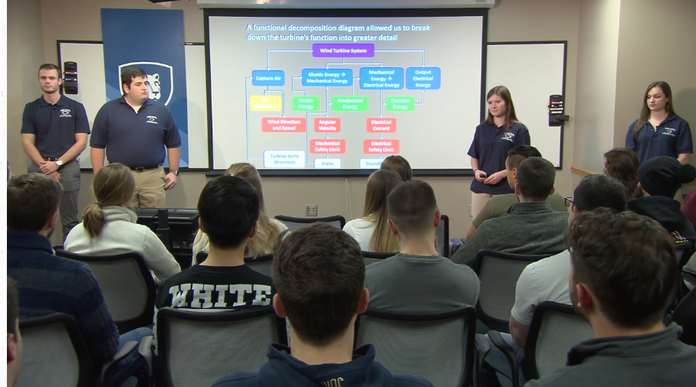
Slide Organization, Design & Delivery
TC496

Slide 2
Suggestion: create a skeleton of your slide deck
Take notes
Create placeholders

Slide 3


Slide Design
Delivery
Storyboarding
How to make the assertion & evidence model work for you
How to communicate your intended message effectively
How to structure and organize your slides

Slide 4
Analyze your audience and purpose
Who are the people in my audience?
How much do they know about my topic?
What do they want to accomplish in listening to my presentation?
Am I attempting to inform, educate, or persuade?
Notes:
The first step when approaching any presentation is to consider your audience and purpose
Is the audience mixed in terms of their backgrounds and knowledge?
How much will you need to explain/define vs. how much prior knowledge you can depend on (set context!)
What do THEY want to accomplish in listening to the presentation
Note: not what YOU wasn’t to accomplish for this part
Consider what THEY want out of this time listening to you and structure your talk accordingly
Now you can think about yourself–what will YOU try to do through this presentation (note: almost everything in life is an argument)

Slide 5
YOU are the presentation;
the slide deck is your visual aid
Notes:
The slide deck serves as your aid

Slide 6
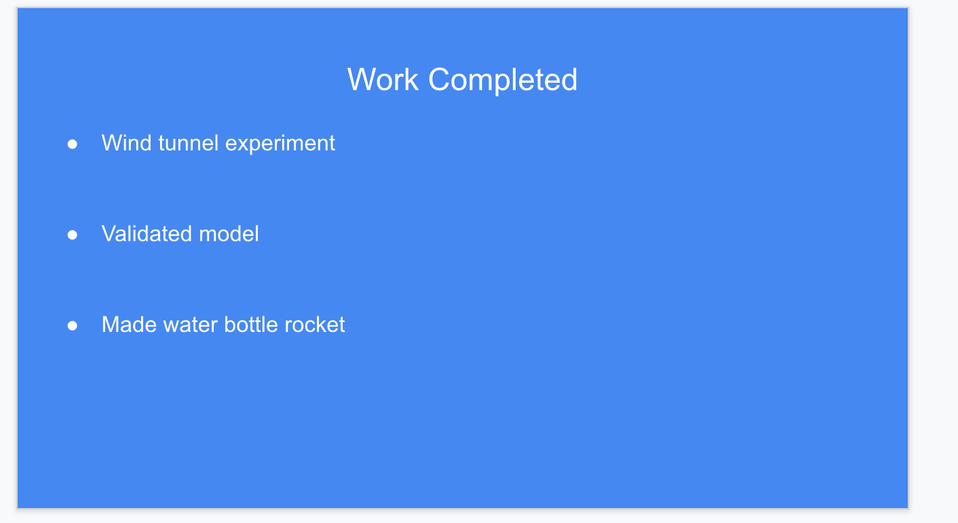

This is a bad slide
Notes:
This is a bad slide; it follows the unfortunate trap we’ve fallen into with slide design
What’s wrong with this slide?
-the color choice (non-data pixels, figure/ground separation)
-the title is a topic as opposed to an assertion
-the bulleted list is unremarkable
-lack of visuals
-the branding is NOT needed (and the image has not been made transparent)

Slide 7
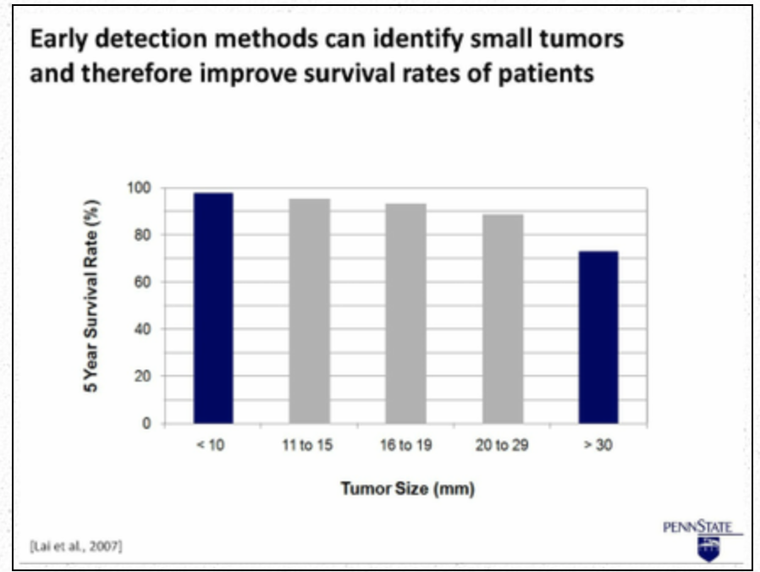
The Assertion/Evidence Model Promotes
Comprehension and Retention of Information
Notes:
This is an example of an assertion/evidence slide
An assertion is situated at the top of the slide
Visual evidence is presented beneath
This is a meta slide–a slide within a slide
Why assertion/evidence?
-It is researched based
-It has been adopted by the UM College of Engineering
-It builds upon Doumont (perceived cognitive load)
-It builds upon Mike (forging for information)
-It makes sense (help your audience: lead them to your main communication objective)
We cannot go back and reread your slides as we would in a report
We are engaging with visuals, text, oral delivery, and noise in the room–an assertion for a title helps us in case we lose your point or in case we get distracted
-Why wouldn’t you place the most important info at the top and in large font?
Do not place important info in smaller font and further down/don’t place a meaningless title at the top in large font
Do not mistake bullet points for organizing information for us (they don’t)

Slide 8
The Assertion/Evidence Model Promotes
Comprehension and Retention of Information
Notes:
Instead of basic titles/topics like “agenda”, “progress”, “work left to be completed” or “conclusion”, use titles that are specific, help forward your argument, and serve as sign posts or thesis statements for your audience
Consider your audience: they are listening to you talk, they are viewing the slide visually, they are reading the text on the slide,
The person next to them coughed, the lab next door is loud, they are thinking about where they are going to order lunch,
If they get confused or distracted, they can easily look back at that assertion title and know exactly what content they should be following
Remember that unlike a report, your audience cannot “go back” and reread your slides or re-hear your delivery–we get one shot, and so these titles serve as signposts and they guide us through the crux of your presentation
Now, can you use this model of title 100% of the time? NO. But you can probably 90% of the time
And doing so will result in a more clearly structured and articulated presentation that your audience will actually understand and be able to follow!

Slide 9
The Assertion/Evidence Model Promotes
Comprehension and Retention of Information
Notes:
A visual at the bottom provides evidence or proof of what you are asserting at the top of the slide
A visual can be an image, graph, plot, infographic, etc.
You can use animation, direct labels, or callouts to add text to images, when needed
Note: If you are concerned that someone viewing the slide at another time won’t understand the context of your slide deck without more text,
Include that text in the speaker notes (something to consider for us, too!)

Slide 10
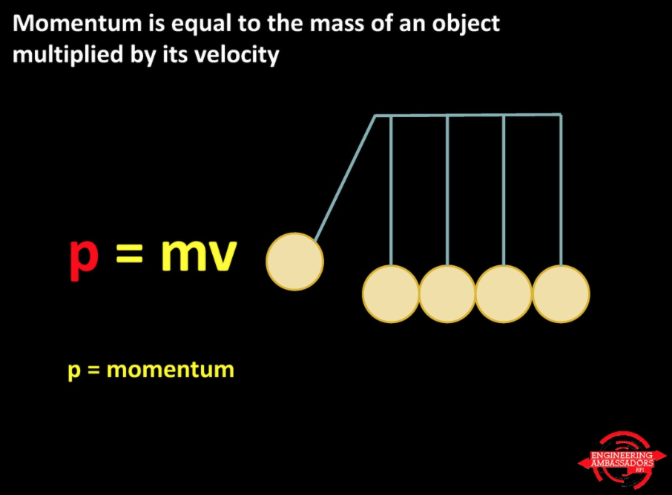
Notes:
Here is an example of an assertion evidence slide
The title makes a statement–it tells us the key point the presenter wants to make here
The visual directly corresponds to and proves the assertion (with the help of oral delivery)
(This slide also takes the brave stance of having a black background!--this can be tricky to work with!)

Slide 11
Experimental Design for Optimal Welding Conditions
Toute Vitesse Body Project
JORDAN LEEK, DON NOI, SAM PETERS, ABDUL SINGH
SECTION 4, TEAM 3
Notes:
This is an example of a title slide that is very bad. Mostly non-data pixels.
There is hardly any figure/ground separation, the two titles are confusing
Eliminate the background design

Slide 12
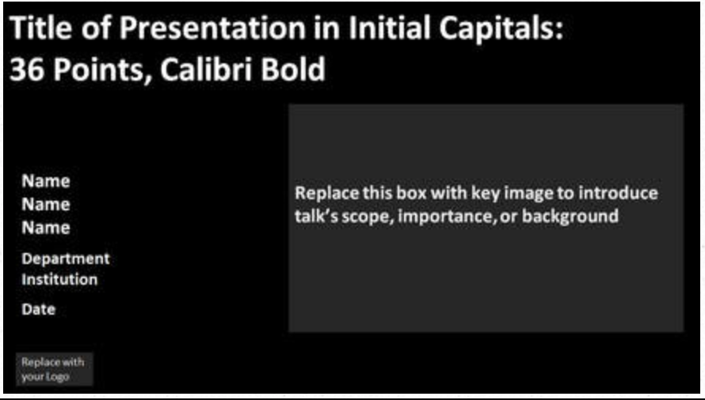
Make the Title Slide Useful
Notes:
This could work as a template for the title slide
Use this space to create a title that is descriptive toward the task
Include an image that relates to the title/your main point or objective

Slide 13
Which title is best?
Progress Update of Flight Characteristic Exploration
of Low-Cost Pressurized Rockets
ME495 Lab 3 Progress Report
Pop Bottle Rocket: Section 10 Group 2
Water Bottle Rocketry
Progress Update on Rocket-Assisted Weather Balloon Launch
Notes:
Speaking of titles, choose one that describes the content and objective of the presentation
#5
Progress update or something of that nature should be in your title, along with a summary of the main tasks given/objectives of the lab
Let’s now discuss the agenda slide

Slide 14
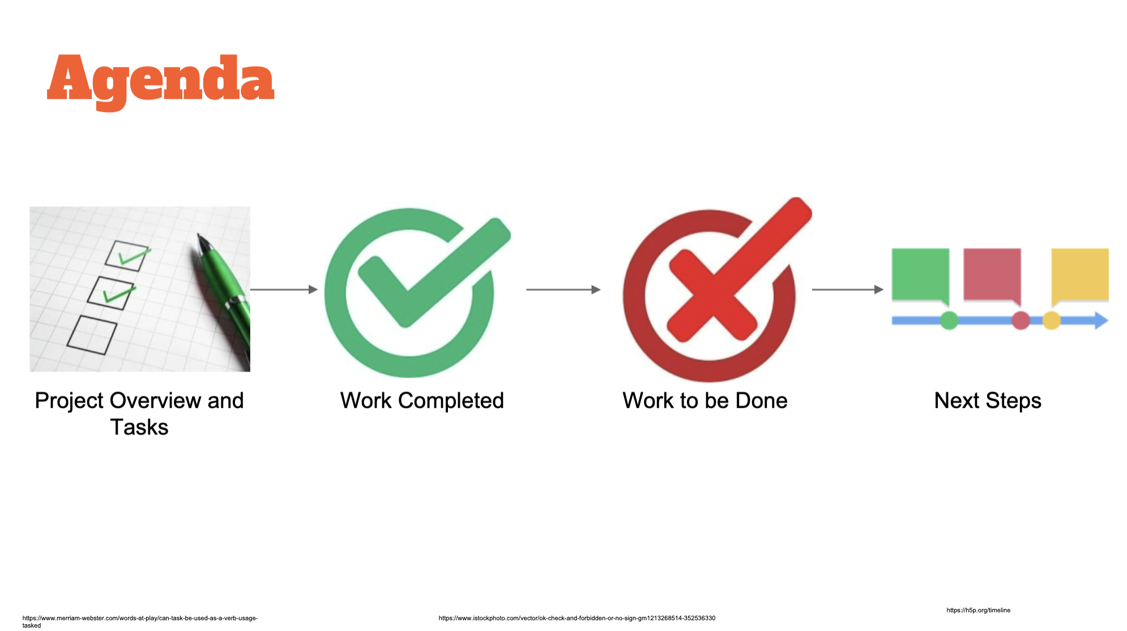
Notes:
Not the most helpful agenda slide
Create content-specific parts to the presentation:
Choose images that help us understand each of these tasks

Slide 15
Agenda
Introduction
Methods and Procedures
Results
Discussion
Conclusions
Recommendations
Questions
Notes:
Common agenda slide. This is bad. Not specific to the individual presentation. Could apply to millions of presentations
This is boring, uneventful, and really does not tell us anything!

Slide 16
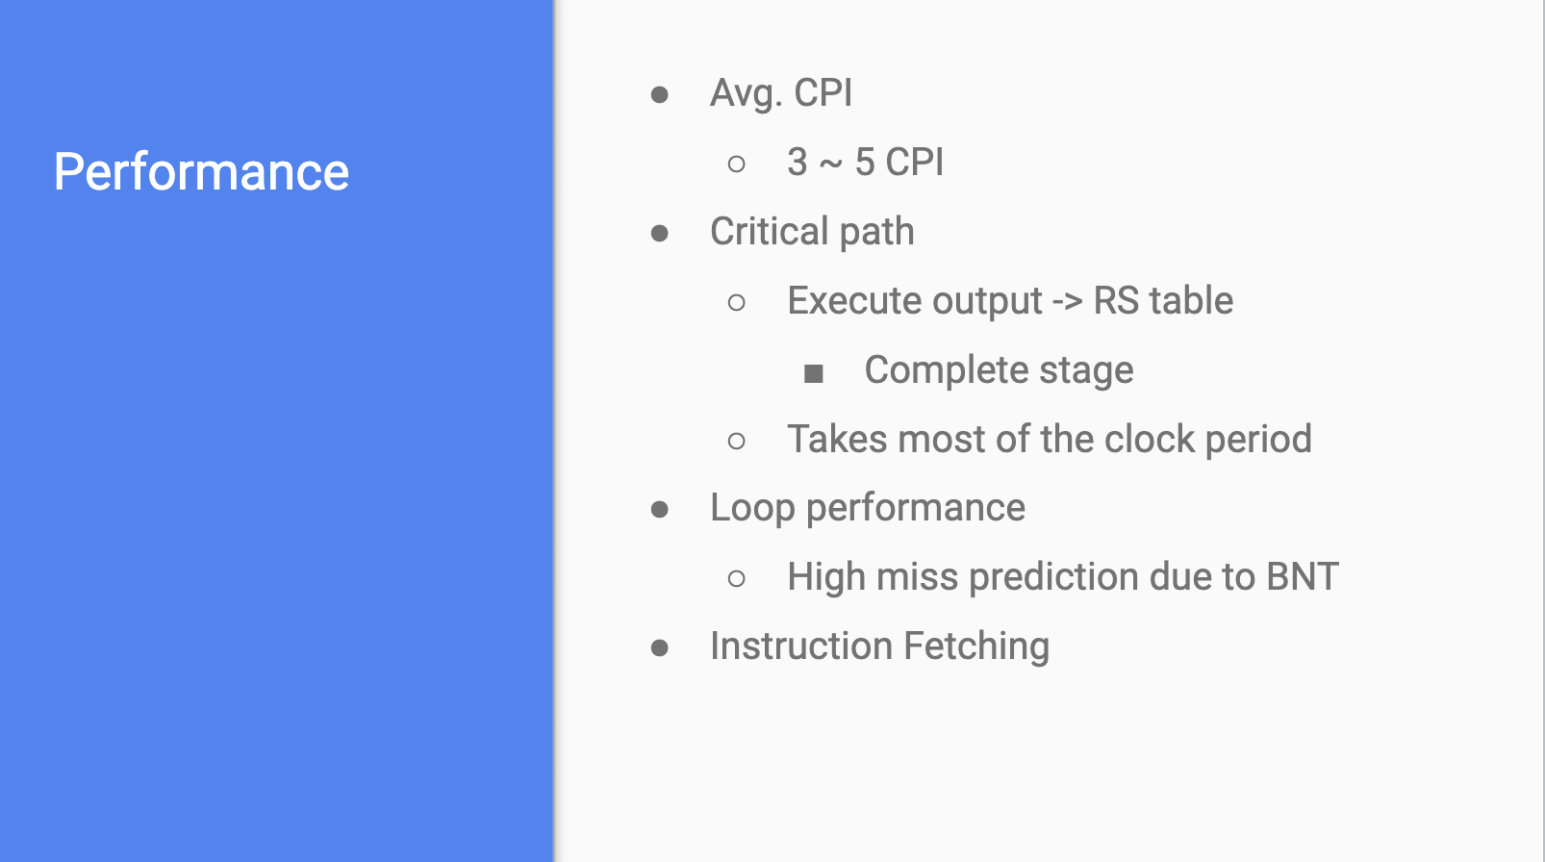
Notes:
“Performance” section should tell us more; this is wasted space
Every other bullet could be combined here, or could make this into a table, or use a visual to represent this info
Much of this could probably be said in the oral delivery vs. placing it here
Imagine the delivery to this–they probably just read the slide word-for-word

Slide 17
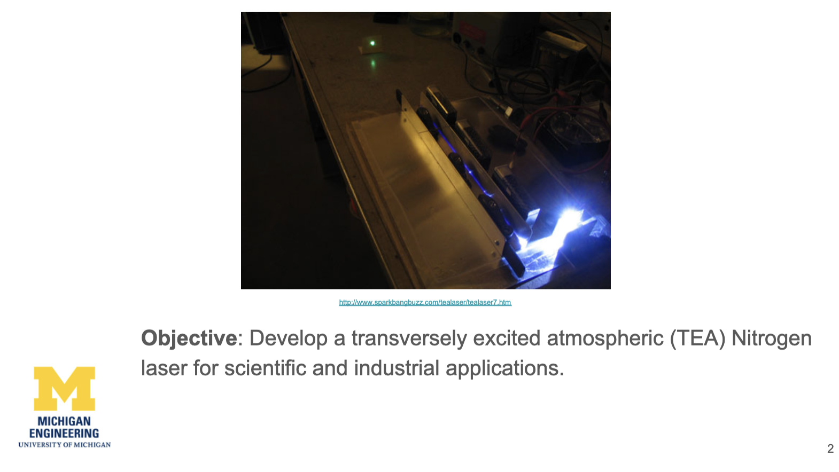
Notes:
Loud branding
No clue what this image is showing me
Text could be at the top

Slide 18
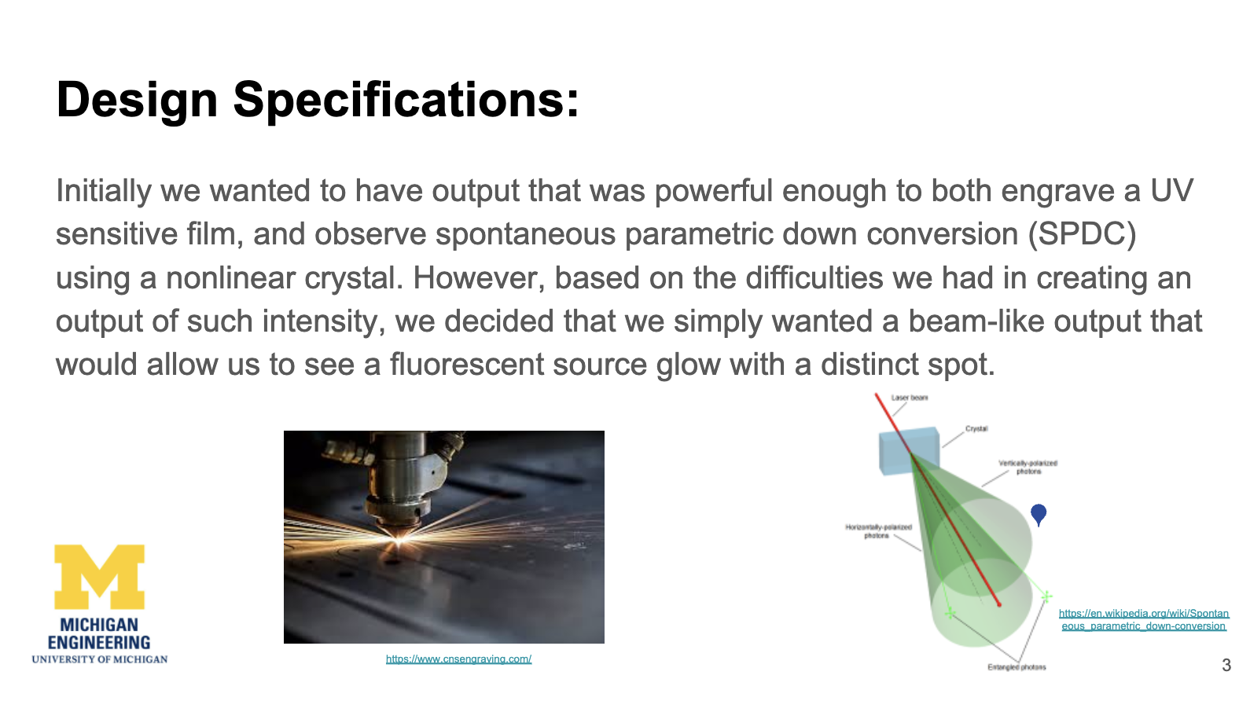
Notes:
Why is there a paragraph on a visual aid?
Imagine the delivery of this slide–did they just read it to the audience?
Too loud branding
The images are too small; cannot read the labels on the right and the left side seems to be a stock image?

Slide 19
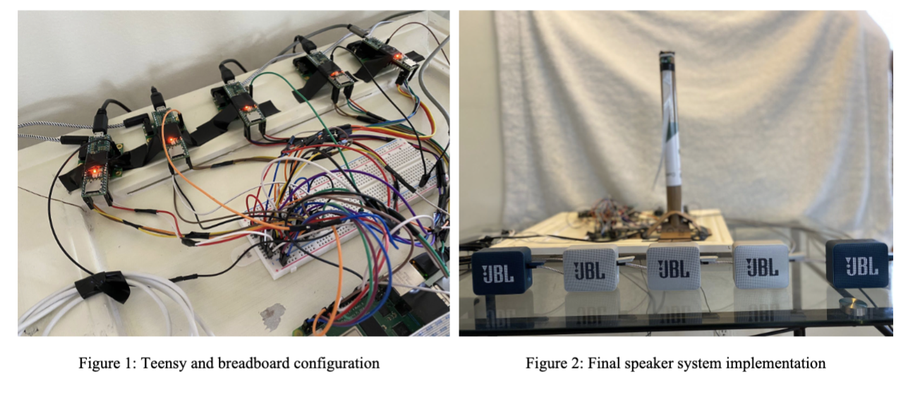
Notes:
Labels are needed; as is a title
Right photo–what am I meant to look at?

Slide 20
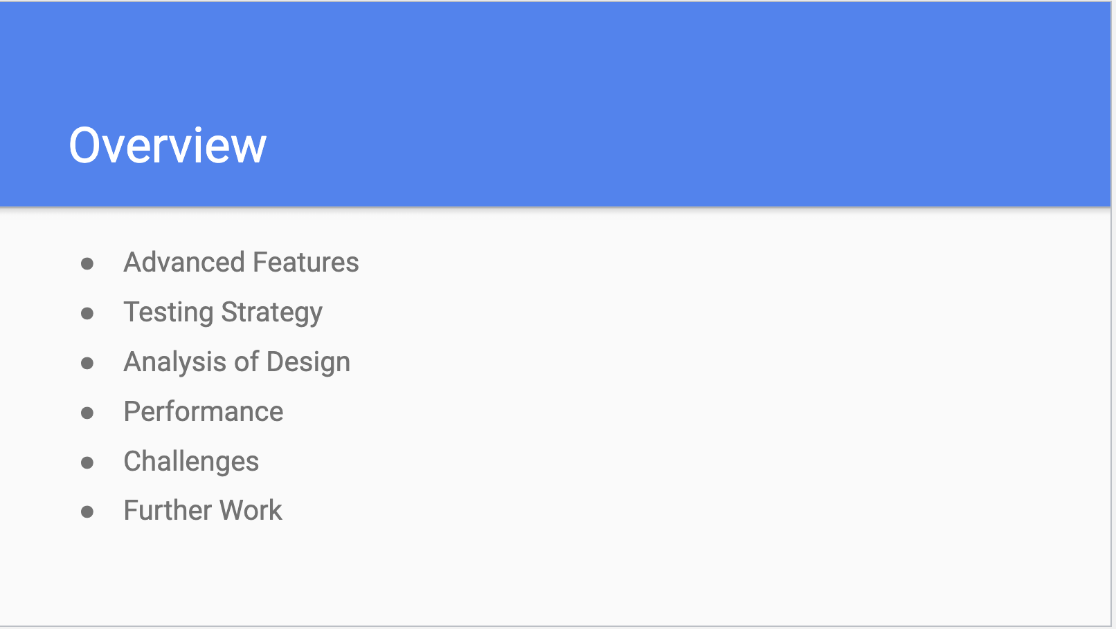
Notes:
I like a horizontal agenda with an image that represents each part
For a longer presentation, you can reuse that image for each section to create flow and organization to the presentation
This is not needed for a 5-minute presentation!

Slide 21
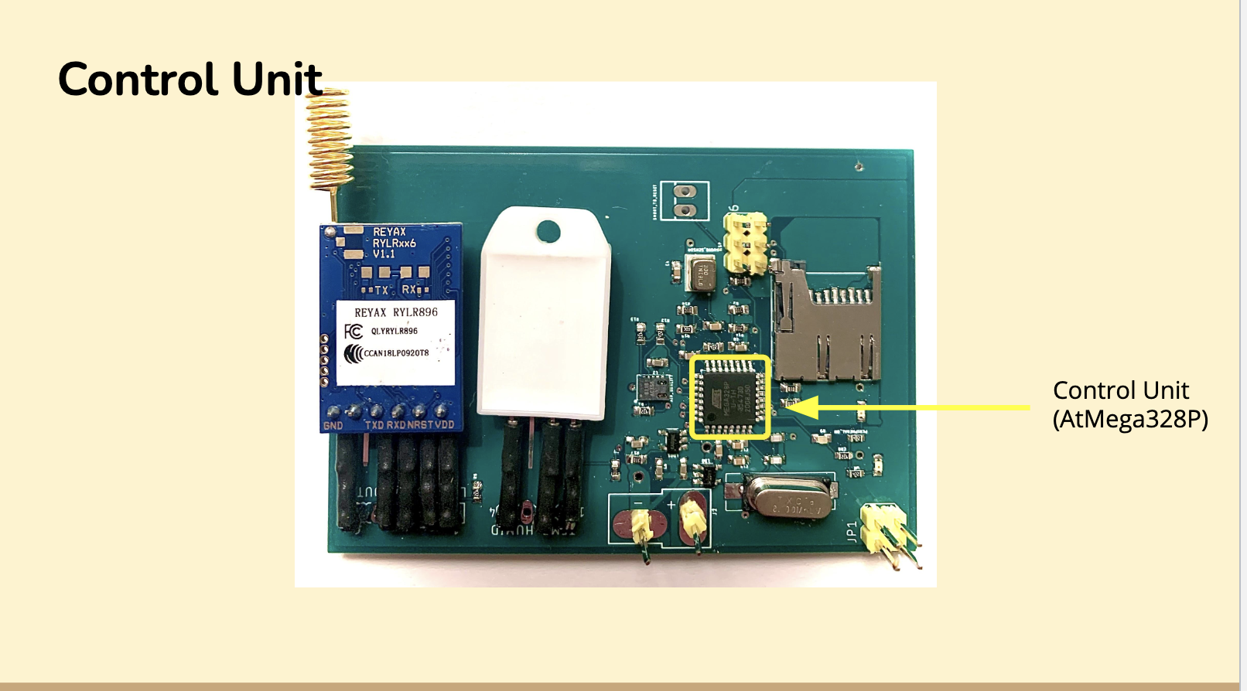
Notes:
Title bleeds into the photo–make the title an assertion

Slide 22
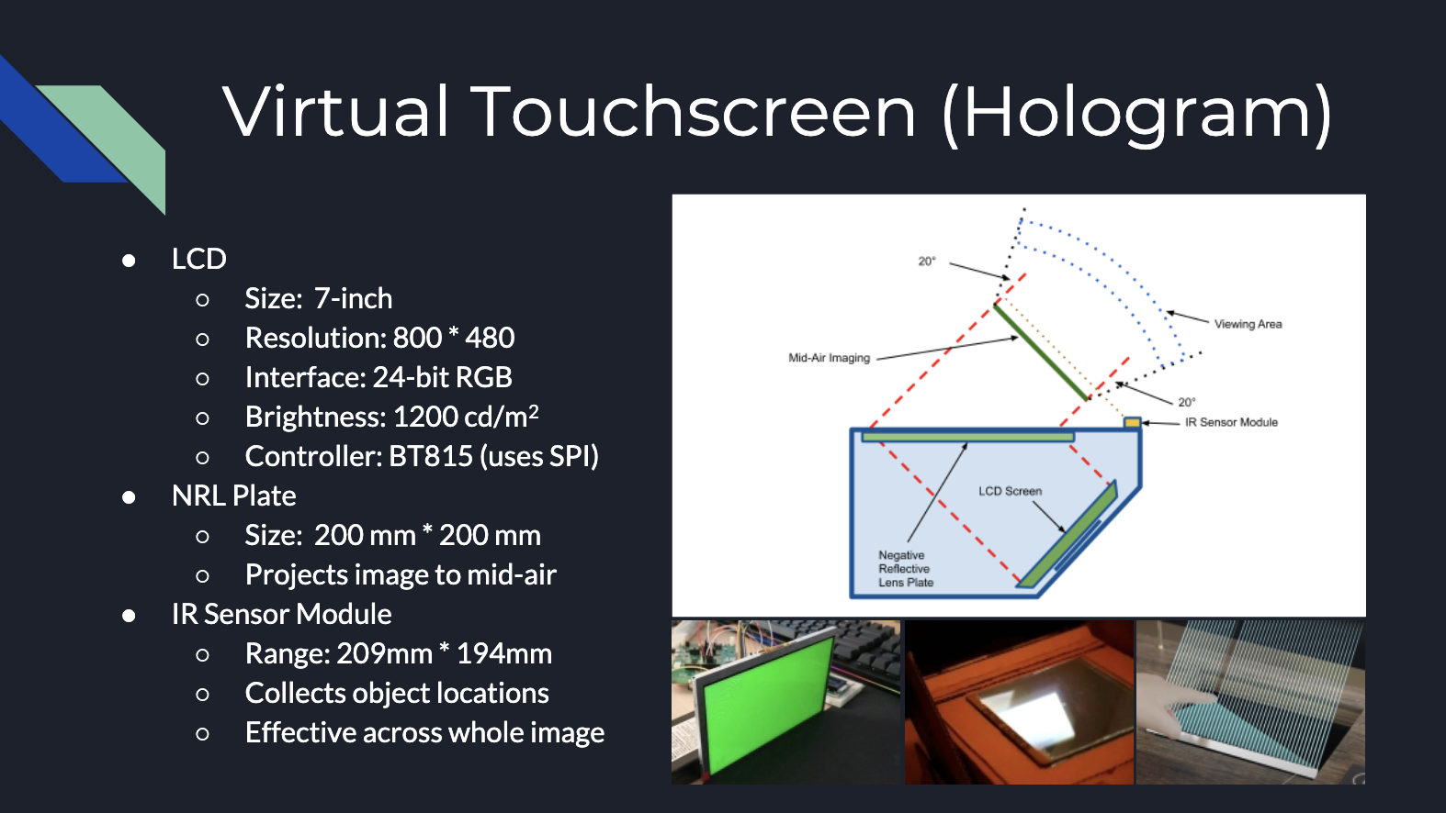
Notes:
Too much happening; this is at least two slides on a single slide
No assertion so we don’t know the main point or argument
This seems more like speaker notes to help the presenter and not the audience
Might this info be organized in a table instead?

Slide 23
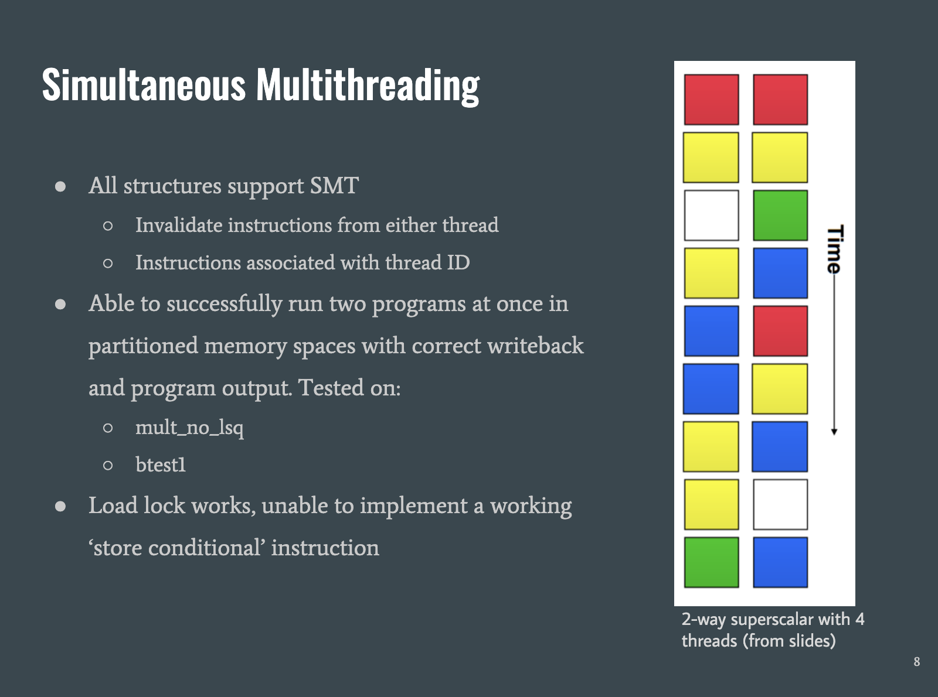
Notes:
Too much text
No title to tell us the argument for this info

Slide 24
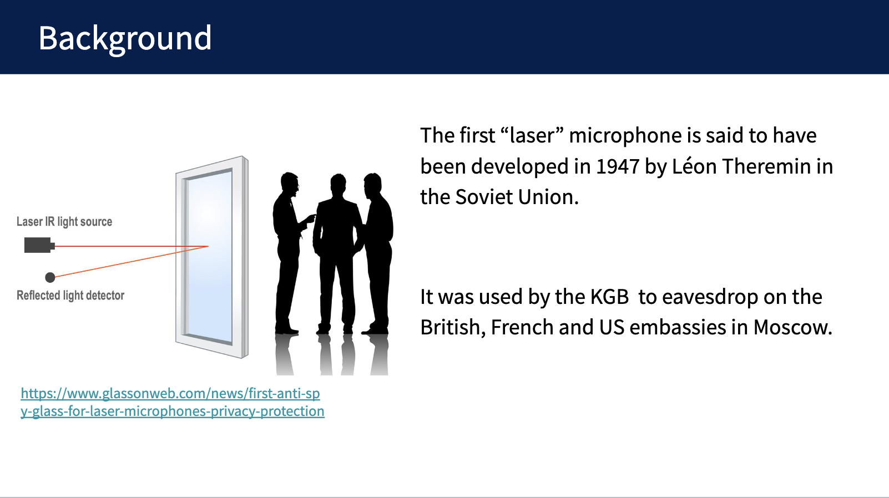
Notes:
Full sentences not needed
Link not needed
Assertion for the title is needed

Slide 25
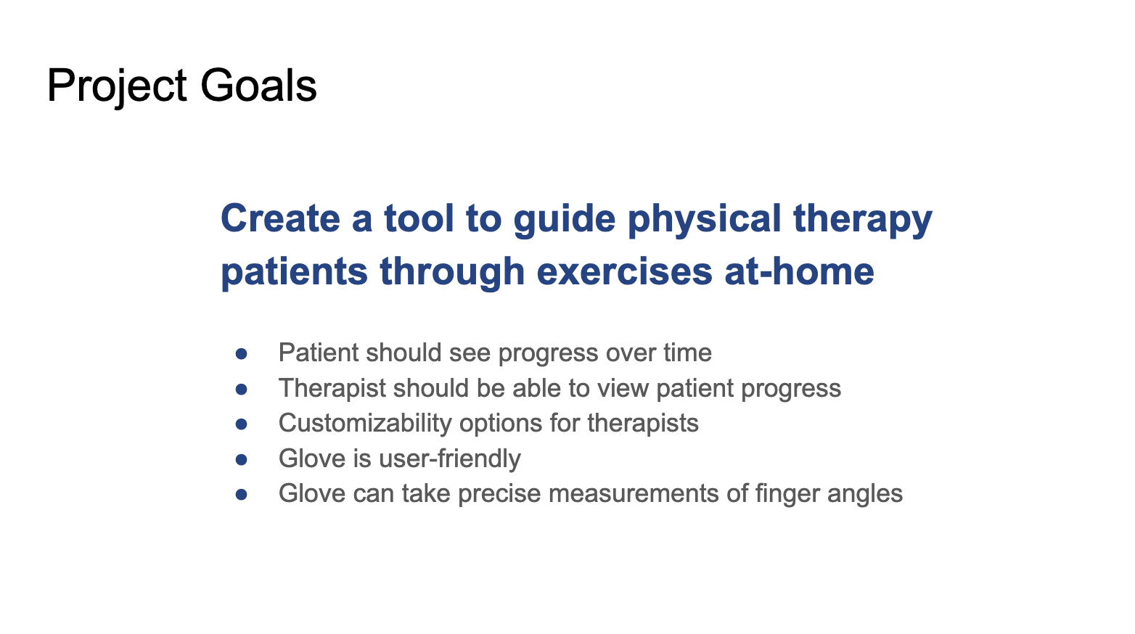
Notes:
This info could be organized via patient vs. therapist
Images would also help

Slide 26
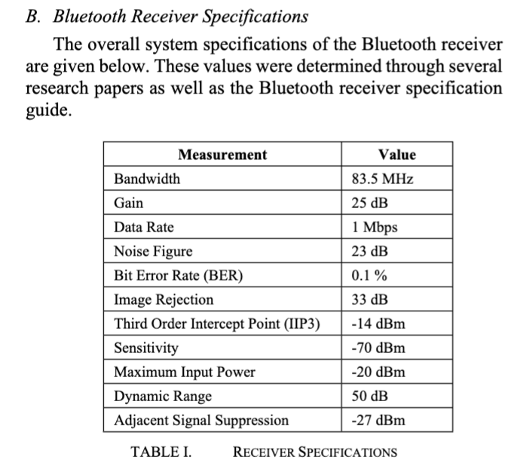
Notes:
How can we reorganize this table?

Slide 27
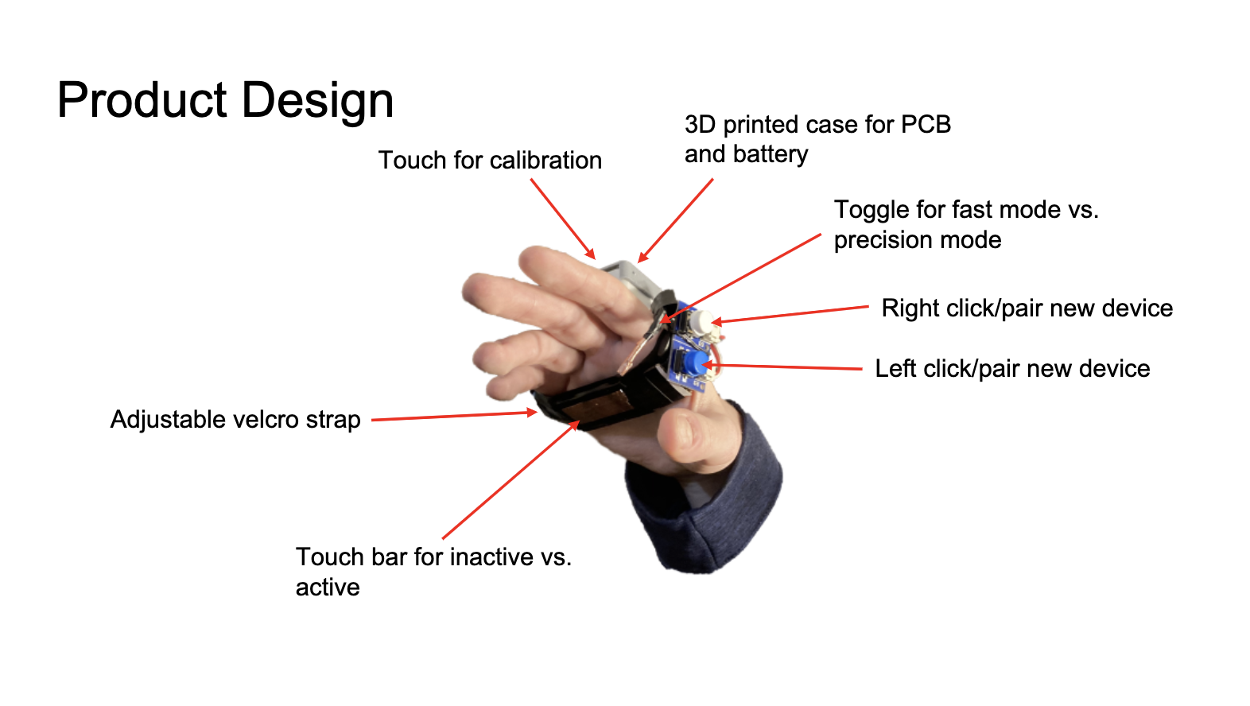
Notes:
Pretty good! But revise the title

Slide 28
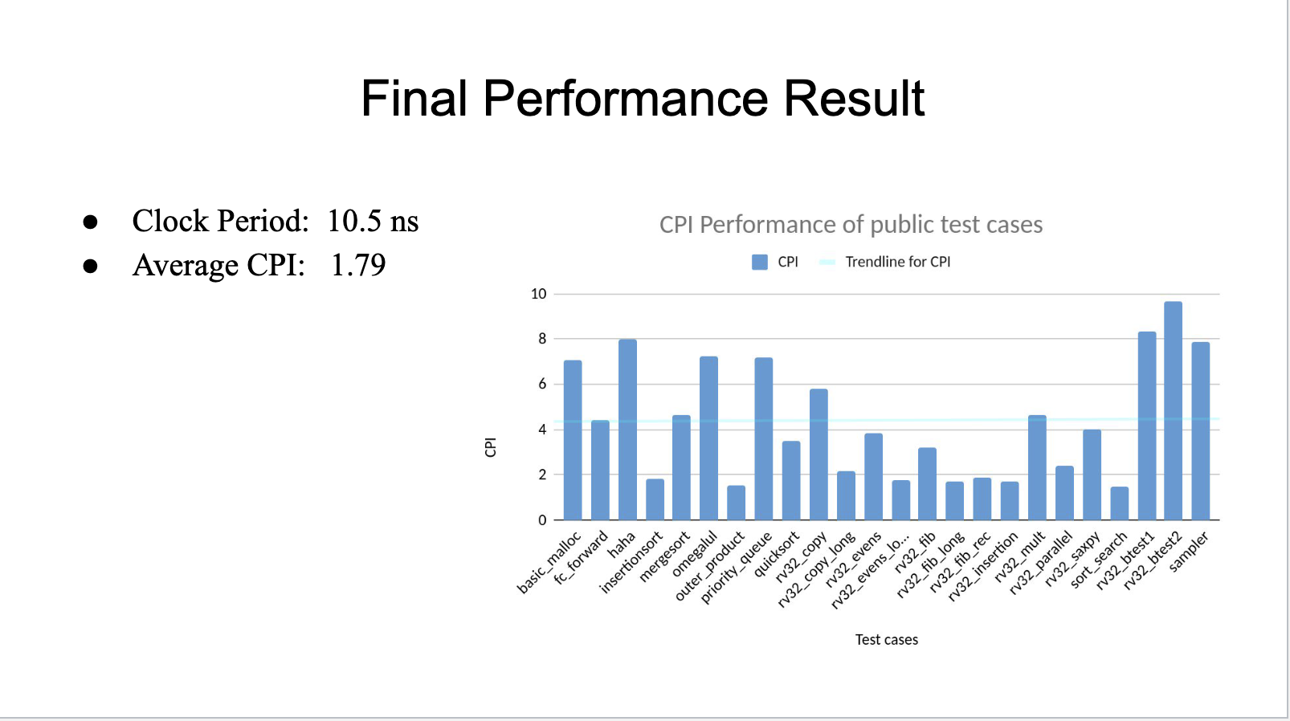
Notes:
Why the bullet points?
Tell us the result in the title—maybe the bullet points should be the title?

Slide 29

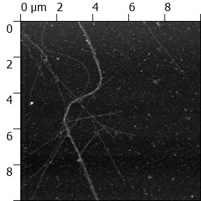
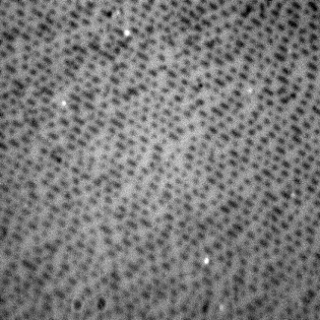
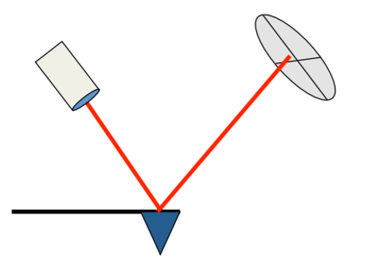
Make the Agenda Slide Useful
There are Four Steps to this Lab
Operation and calibration of Atomic Force Microscope (AFM)
Calculation of maximum storage capacity
Persistence Length of Microtubules
Experiment to Calculate Cantilever Stiffness
ME 495 team slide
Notes:
Agenda slide with visuals, content specific to presentation
USE—Parallel structure, this does not–make into verbs
Aligning a lists in similar structure provides cohesion and it is easier to read
Main points described through text, with a visual that signifies that content

Slide 30
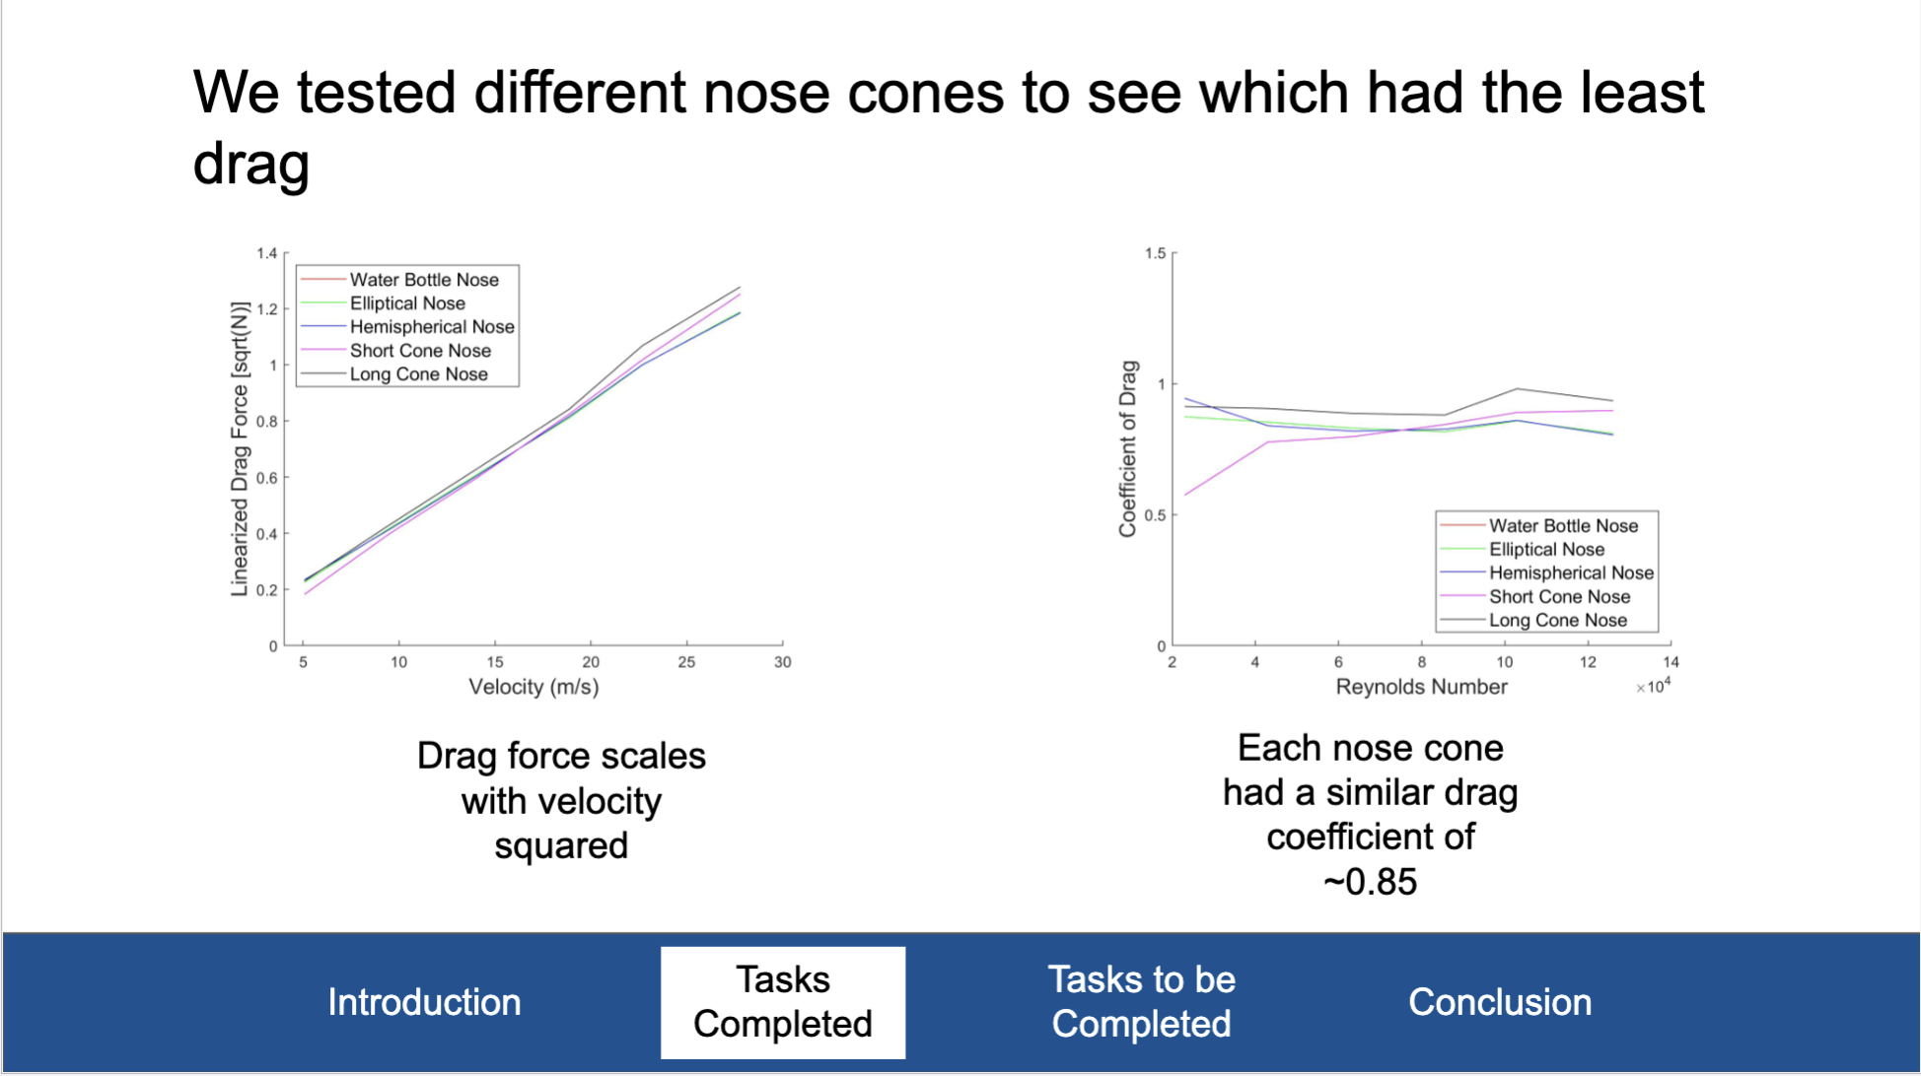
Notes:
Another important aspect is creating an effective presentation is to provide signposts or breadcrumbs for your audience to follow
(NOTE: this is more important for longer presentations)
Here, you see they include a running footer that tells us which section we are on within a larger scope of the entire presentation
This example is a bit intrusive; consider making a smaller footer, or none at all considering the short length of your presentation
But then what should you do?
Smaller footer
Number slides in bottom corner (3/10)
Rely on your agenda/mapping slide
Include clear signposts throughout that tell us the section you are on (replicate the agenda slide with header slides at the start of each new section, or do this work orally in your transitions between sections)

Slide 31
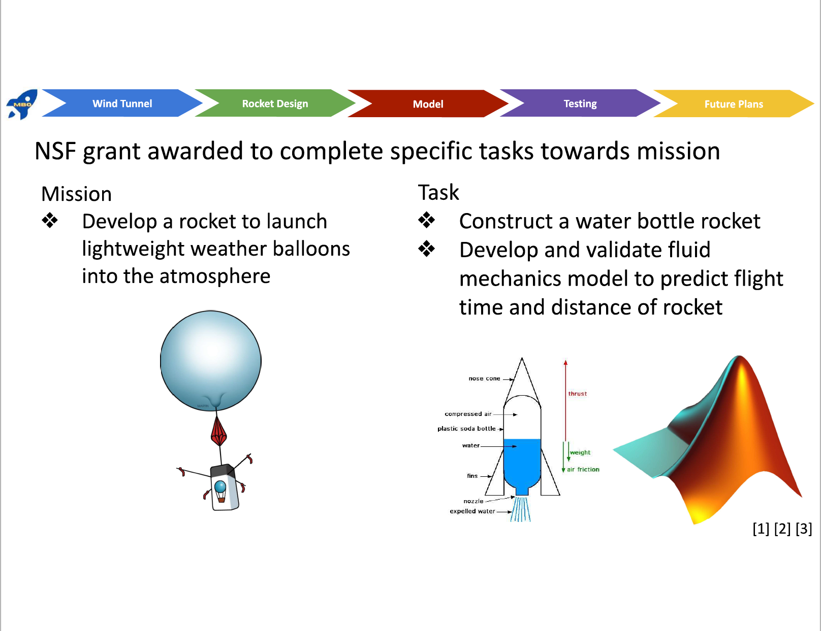
Notes:
This is an interesting slide that does some things right in theory.
It uses the mapping element; but I’d say this is too intrusive, especially since it’s at the top, bold colors, pretty large, etc.
The composition here is a bit off–where do we look?
Be aware of this when creating slides–don’t be afraid to toggle between slides or use many slides (some of which you only stay on for a moment)
You can also use animation to guide the eye of the reader:
Imagine all images NEED to be on this slide–they could click to make them appear as the speaker is discussing each in particular
This is better than cramping too much info on a single slide
Here, the mission could be on one slide and the task would be on the next
The title wording is awkward
There are too many levels of fonts, along with bullets and images; this leads to chaotic formatting

Slide 32
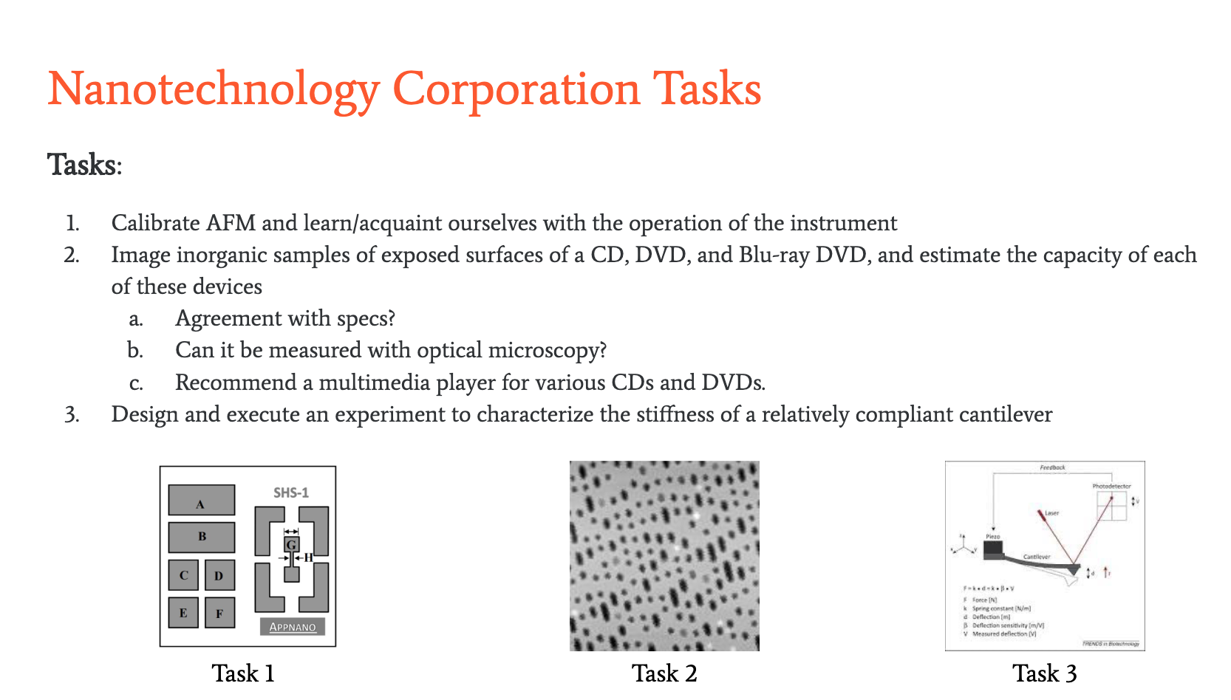
Notes:
Moving into the setting context, here you see an ineffective slide that summarizes the tasks
Here, the images could direct the structurel; the outline text above isn’t needed
these three images could fall on the agenda/mapping slide
And then used on each on those various tasks slides that follow
This isn’t a great example but it can easily be revised!
How many times does this slide use “task”?
The images could make up the major content with some context under
The title isn’t great–this isn’t very specific

Slide 33
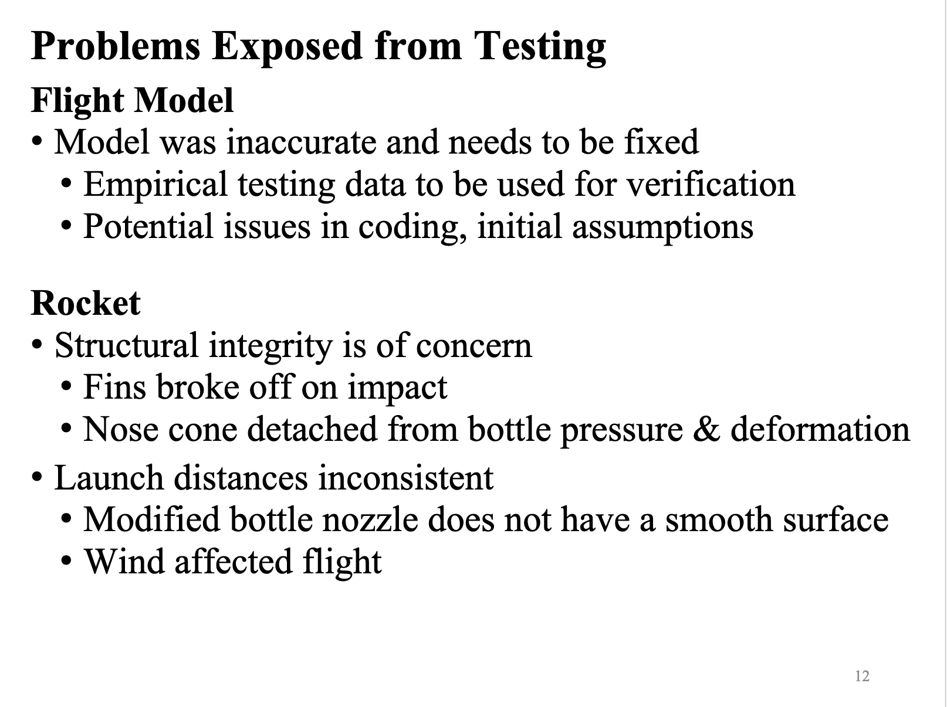
Notes:
This is an example of a progress or work completed slide
Far too much text and NO visual
This appears to be speaker notes for the presenters; it serves no purpose for the audience

Slide 34
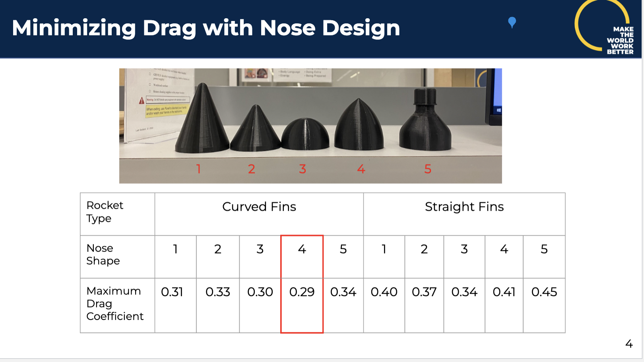
Notes:
Here’s an example of a title that could easily be made into an assertion
They highlight nose #4 so they could make a statement about that nose being the best option

Slide 35
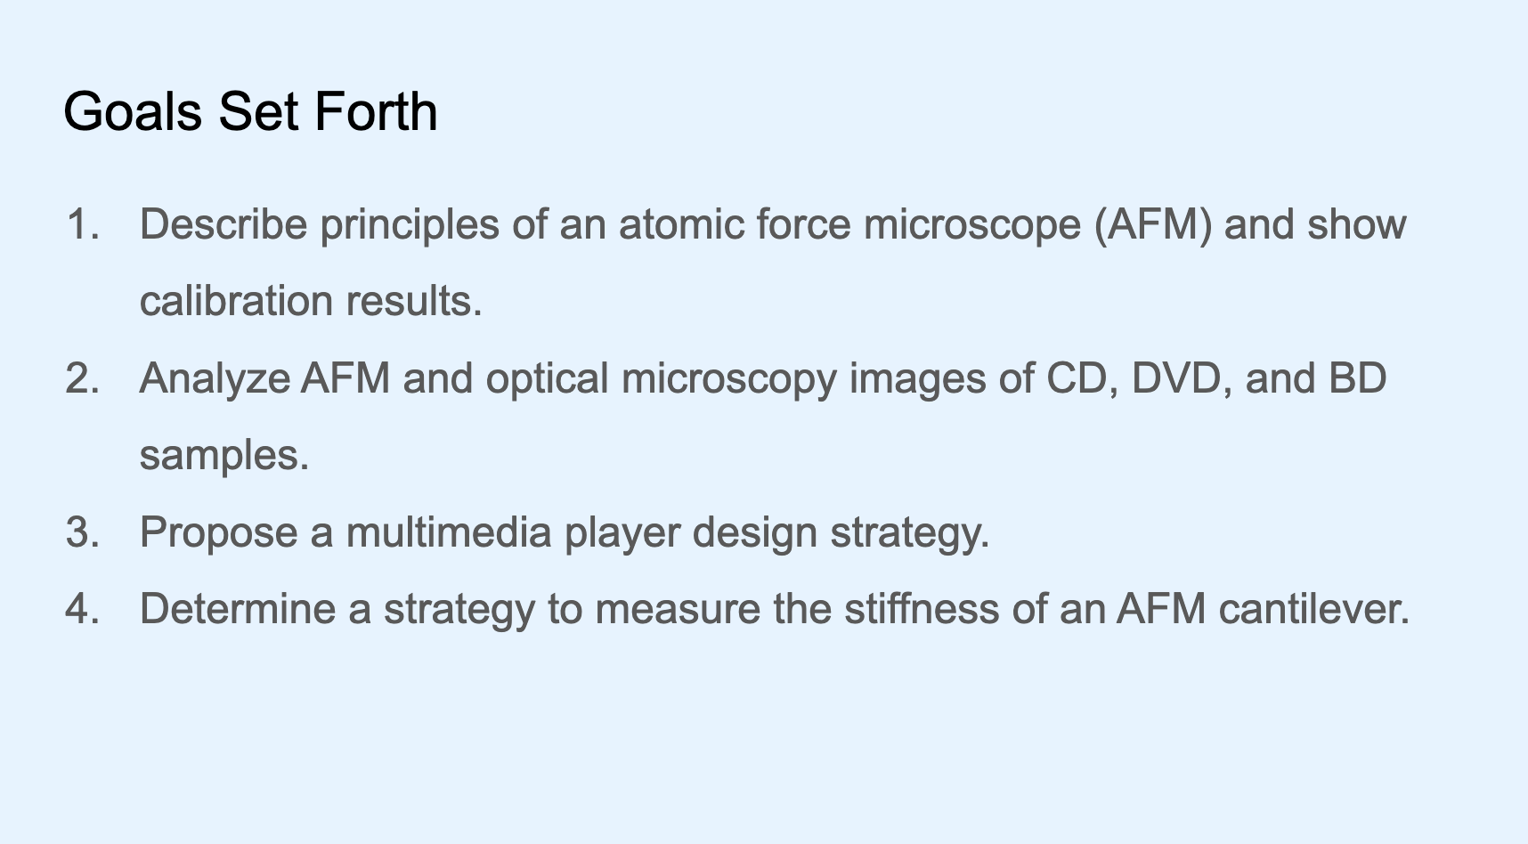
Notes:
Here, they use parallel structure-good!
Title could be revised to state the ultimate purpose/goal
Ideas to make this more impactful?
Images might hint towards their solution for each task

Slide 36
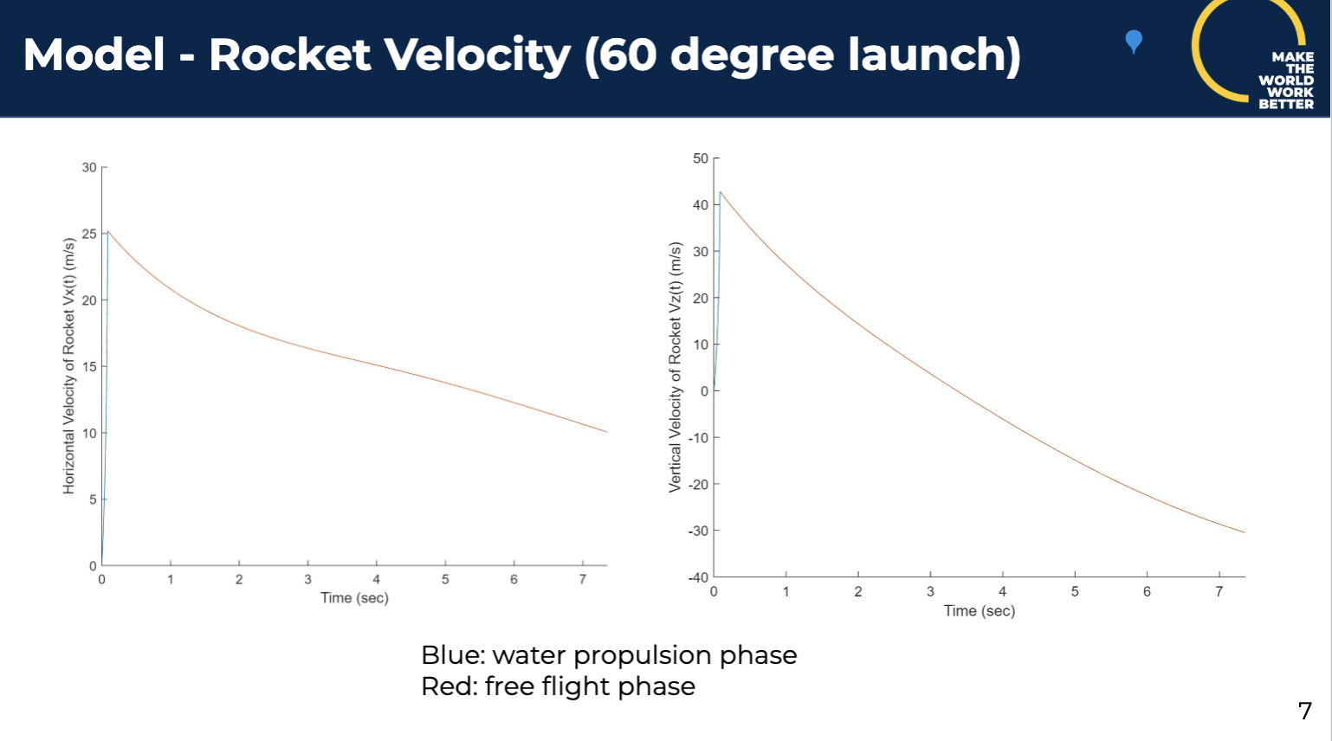
Notes:
Here too, they could make an assertion about the quality of the model
Common issues with the faint lines, small numbers
Don’t forget best practices for creating figures!

Slide 37
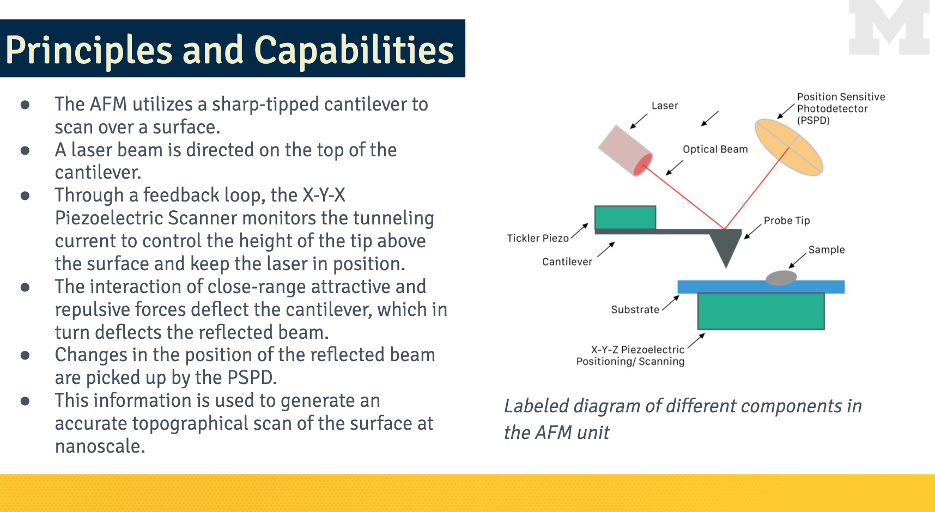
Notes:
Text heavy
Title does NOT match the slide (this is a step-by-step process)
The image should be on its own slide–the text here could be spoken or at the very least, drastically edited
Remove the caption to the image, remove the block M
You may have slides when you need to describe a process or a lot of information: What do you do in those scenarios?
Simply DON’T do that; the title and image should be enough
But if you need to include multiple lines of text, consider animating each point or line so that the audience receives it at a designated time
This is called “progressive disclosure” and is a tactic used so as to NOT overload the audience
Consider a class or completing a tutorial online: it’s helpful to know the milestones and end goal but if we released all three labs at once and told you to complete them by December 8th, that would be overwhelming
You could also give your audience a moment to read the text–Avoid reading a slide to your audience

Slide 38
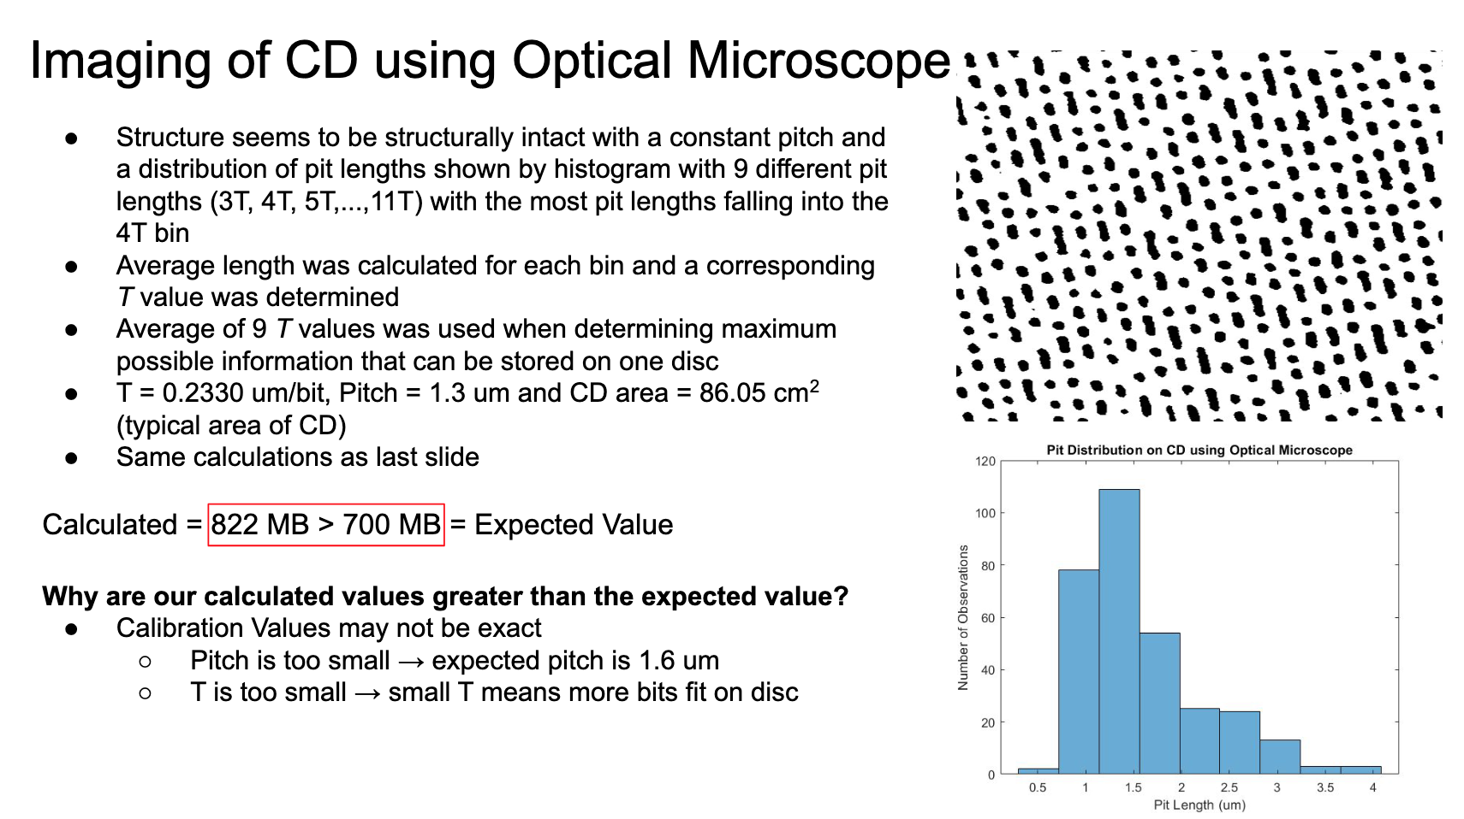
Notes:
What is the purpose of the slide? We are not sure based on the title
Seems to indicate that has been done, but what about it?
This slide design implies you’ve not prepared; the slide is for the speaker to read off of vs. serving as a visual aid for the audience
What is the main message here?
Procedure, results, evidence?
*Pit length is in UMs (this is not correct)

Slide 39
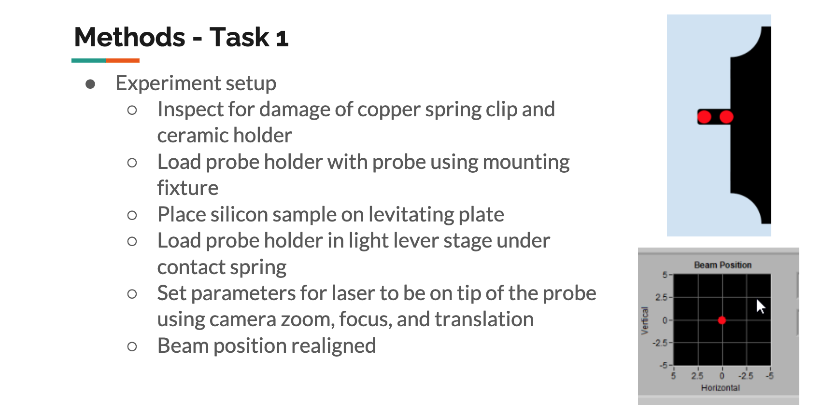
Notes:
Tell us the method or task in the title
A visual of the experimental set up and direct labels with these steps numbered might be nice

Slide 40
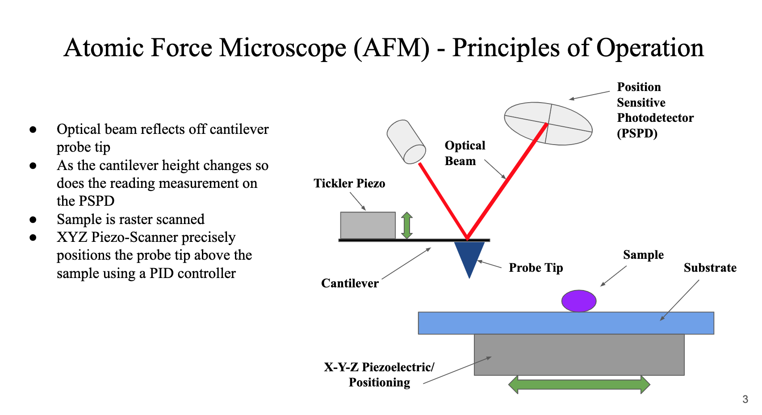
Notes:
This is my idea for the previous slide: include an image and then label the procedure on that image
They do not do that here, but I feel they are getting close to it!

Slide 41
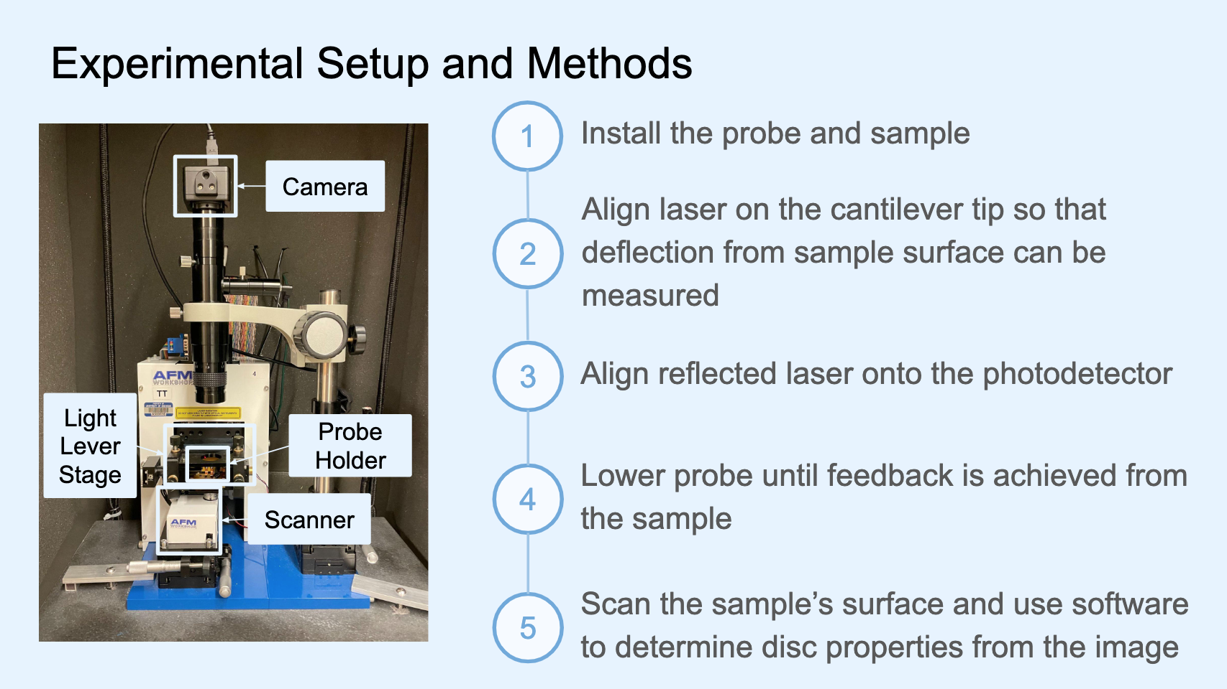
Notes:
Nice design
I think the blue could be eliminated
Arrows could point to the particular parts on the microscope

Slide 42
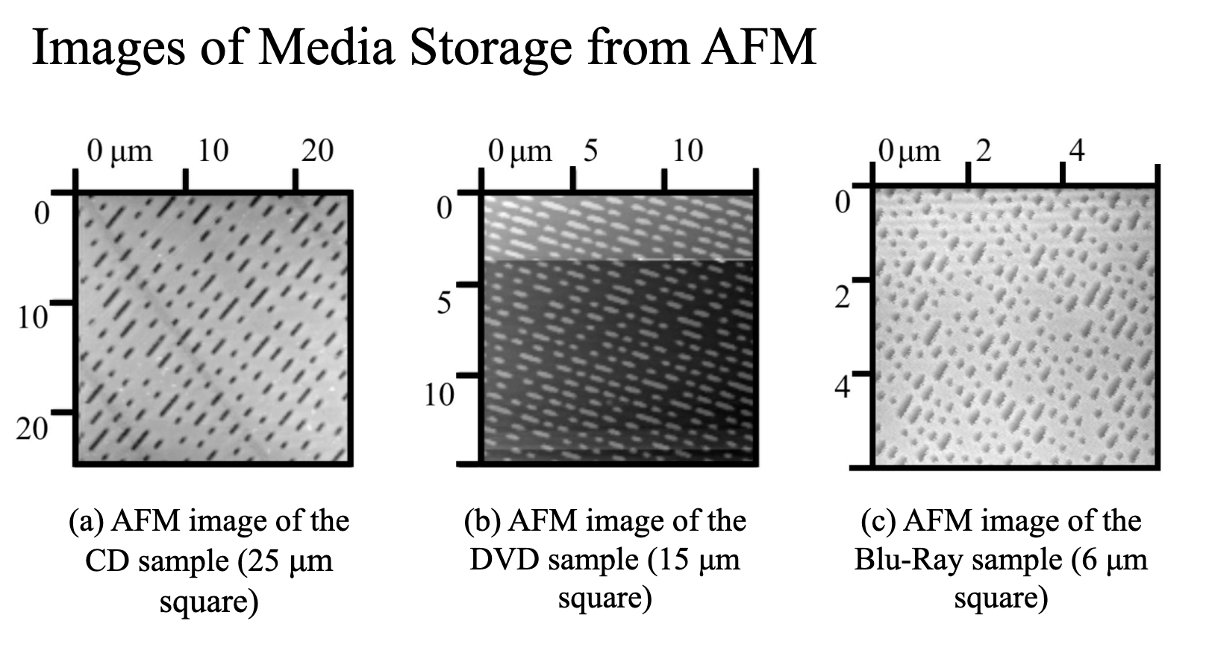
Notes:
I generally like this slide!
Images are nice and large and are labeled
The text below images could be edited a bit
The title here might be an assertion so that we know how this fits into the larger scope of the presentation
(but it is situational and depends on what preceded and what follows)

Slide 43
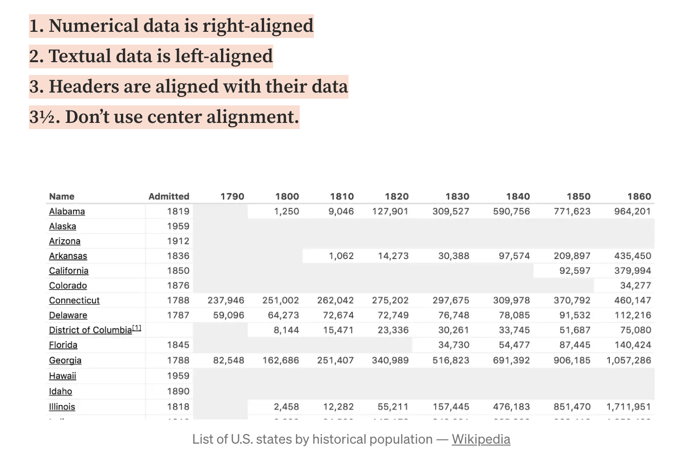

Slide 44
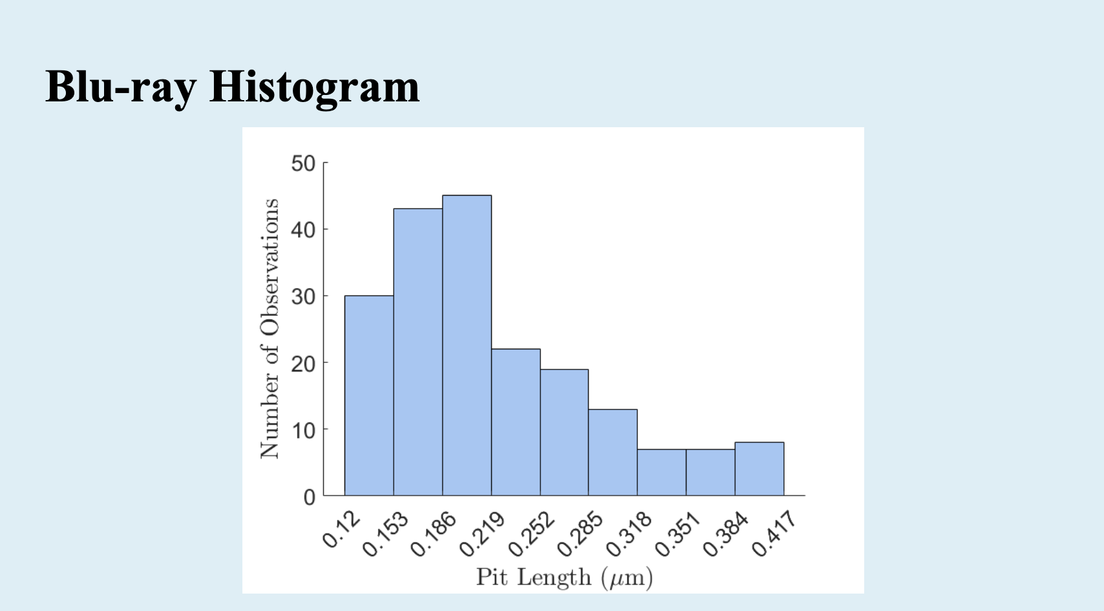
Notes:
Tell us what to do with graphs, if you include them
The title could tell us what this proves!
Direct labels, arrows, or color could indicate a specific data point we are meant to observe

Slide 45
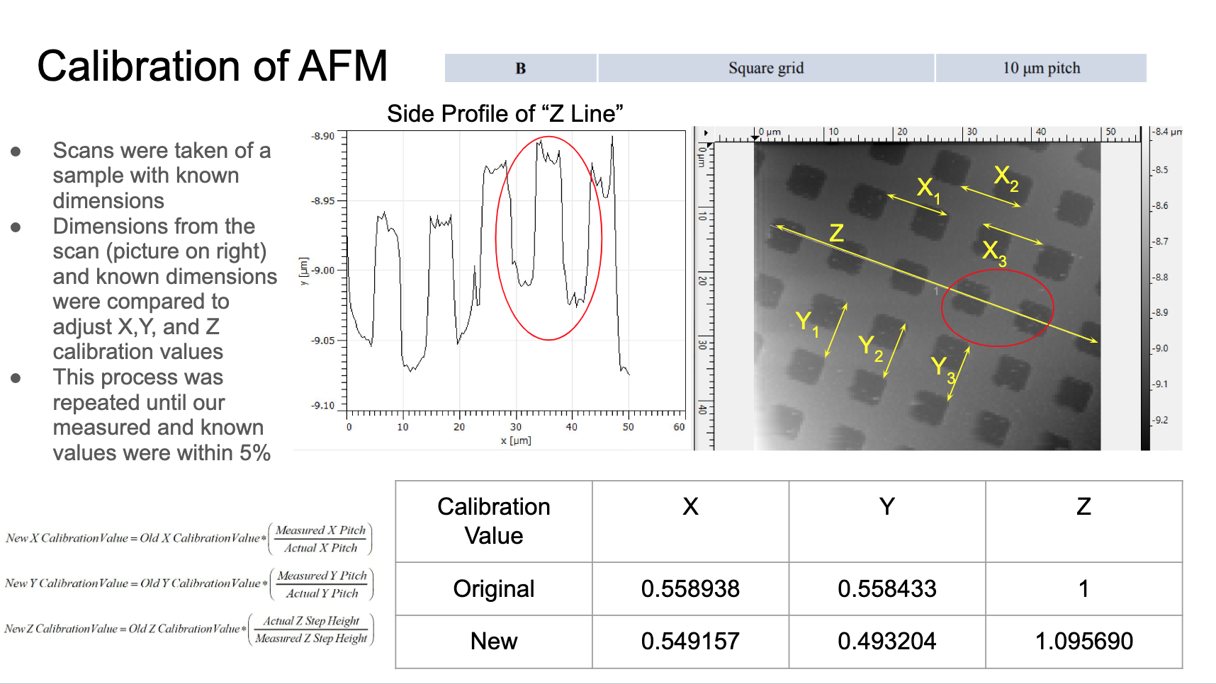
Notes:
This is a lot; in terms of composition, I don’t know where to look on the slide
DO NOT BE AFRAID OF USING MANY SLIDES!
This should be broken up into several slides, or if information is comparative, you might use animation or labels drawing such comparisons

Slide 46
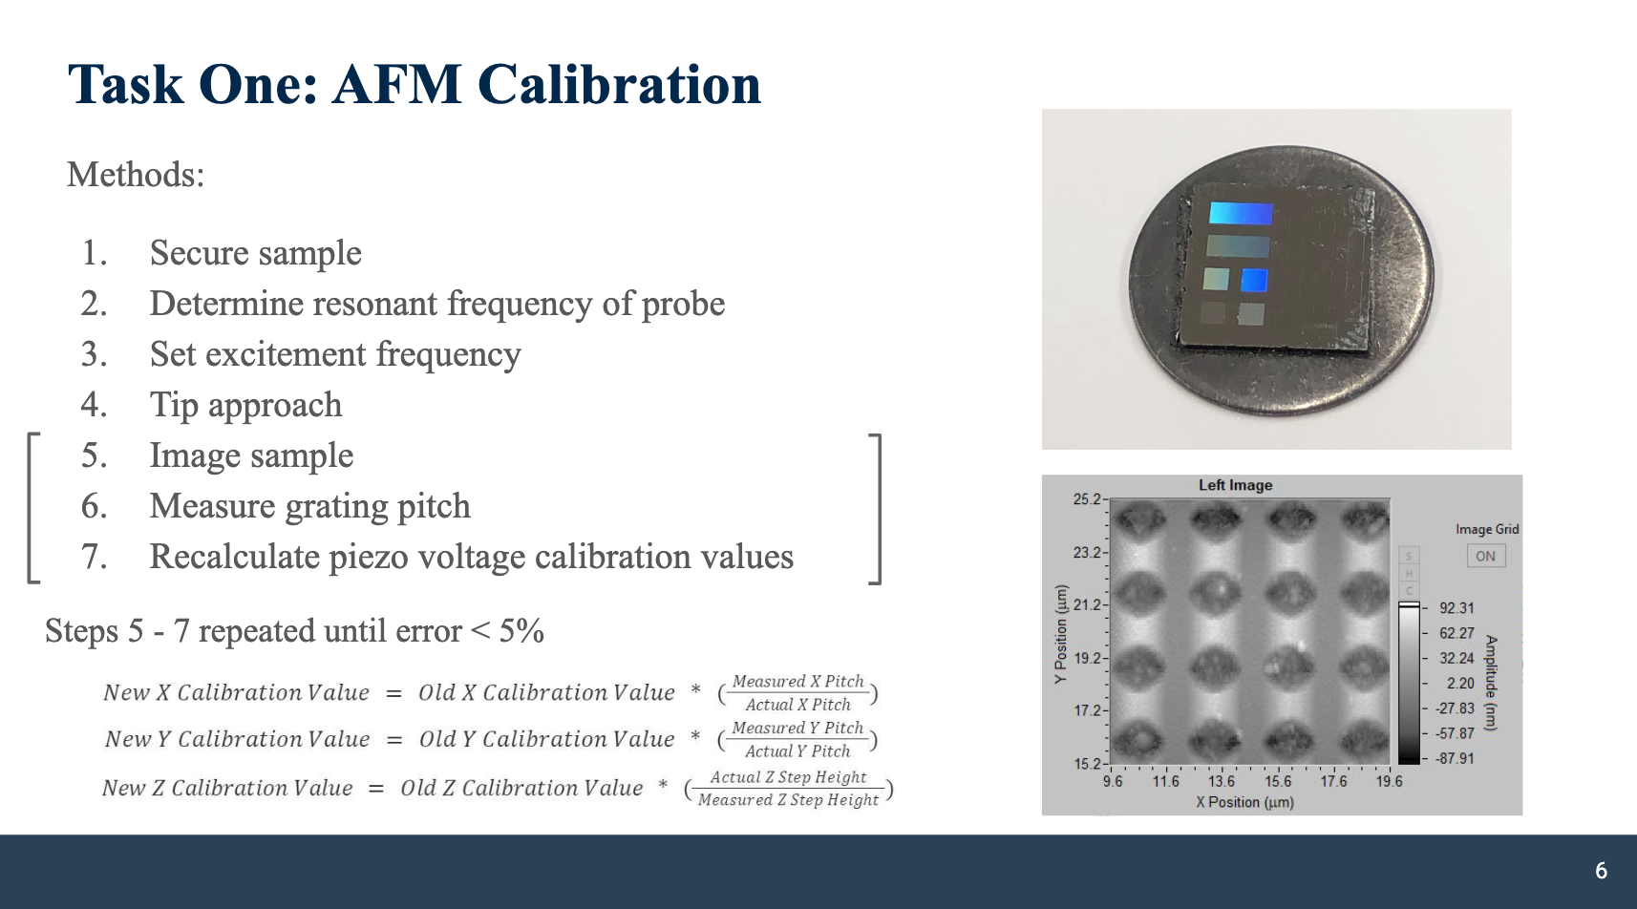
Notes:
Again, this slide has a lot going on
I like that they defined task one
But images aren’t labeled
I’m not sure how one element connects to the other
Use animation IF you need multiple elements on a single slide

Slide 47
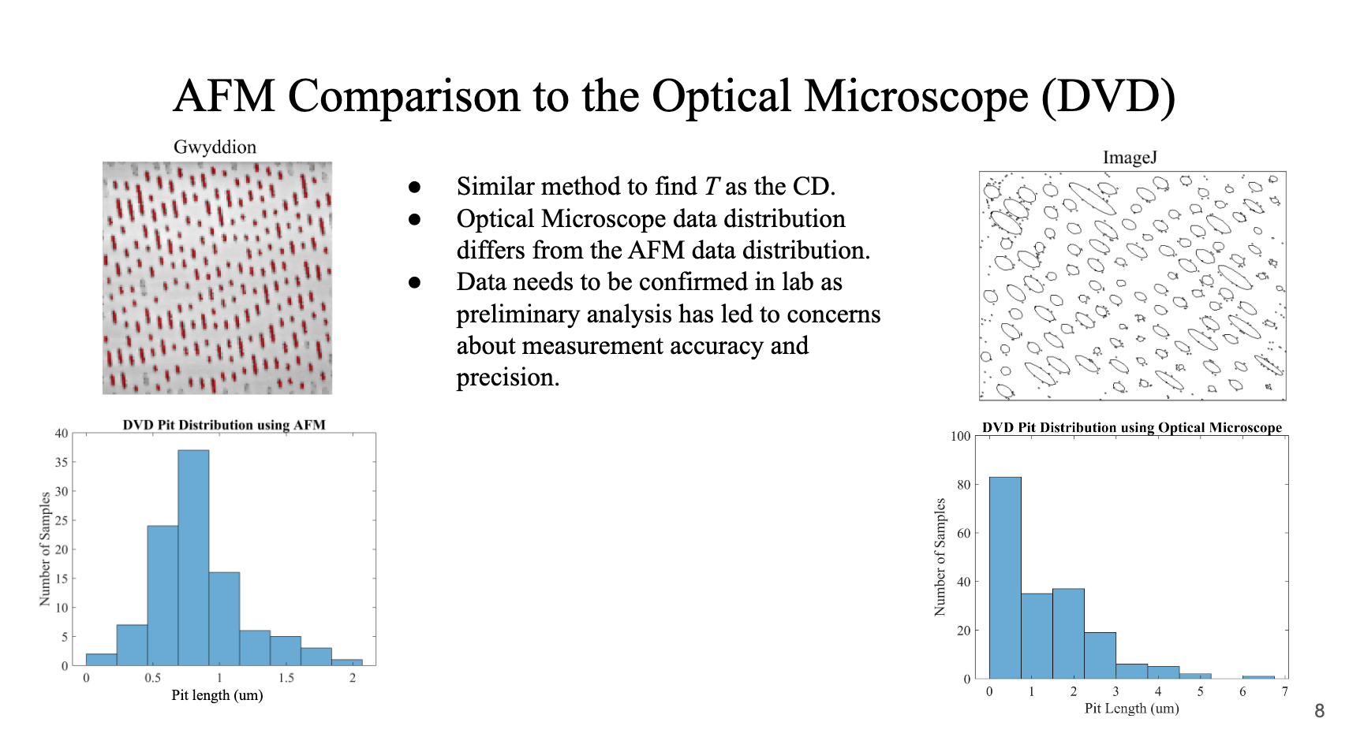
Notes:
Here, composition is simply off
Elements should align better
The title could be an assertion, easily!
I like the general idea, but I think it could be streamlined

Slide 48
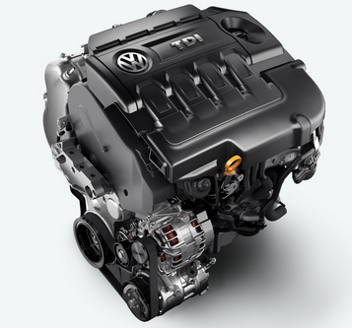
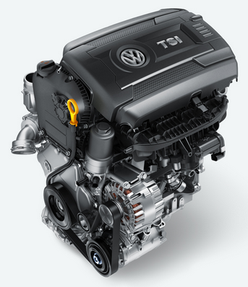
Diesel Engines Outperform Gasoline Engines in Several Key Areas
2.0 L, 4-cylinder
150 hp @ 3500-4000 rpm
236 lb-ft @ 1750-3000 rpm
Compression Ratio - 16.2:1
EPA MPG Rating- City: 31, Hwy: 46
Volkswagen Jetta 1.8T Sport TSI Gasoline Engine [19]
Volkswagen Jetta TDI Clean Diesel Engine [18]
1.8 L, 4-cylinder
170 hp @ 6200 rpm
184 lb-ft @ 1500-4750 rpm
Compression Ratio - 9.6:1
EPA MPG Rating- City: 25, Hwy: 37
ME 495 team slide
Notes:
The previous slide sort of reminded me of this
Here, we want to compare two like things
A good example of parallelism, but could be improved to cut repetition

Slide 49
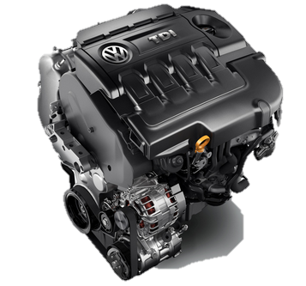
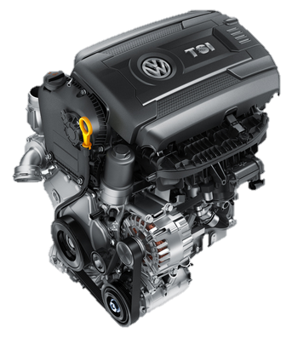
Diesel Engines Outperform Gasoline Engines in Several Key Areas
Volkswagen Jetta TDI
2.0 L, 4-cylinder (diesel)
150 @ 3500-4000 rpm
236 lb-ft @ 1750-3000 rpm
16.2:1
City: 31, Hwy: 46
Volkswagen Jetta TSI
1.8 L, 4-cylinder (gasoline)
170 @ 6200 rpm
184 lb-ft @ 1500-4750 rpm
9.6:1
City: 25, Hwy: 37
engine
horsepower
torque
comp.ratio
MPG
Notes:
Revised slide
More symmetry, eliminates redundancy
Less clutter and less noise

Slide 50
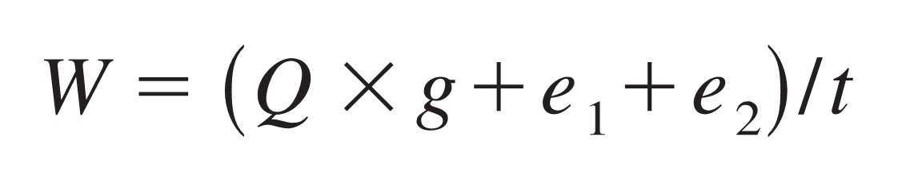
Calorimeter Calibration Equation
Heat of Combustion, Benzoic Acid, MJ/g
Mass of Benzoic Acid tablet, g
Corrected Temperature Rise, C
e₁ = Correction, Heat of Form. Nitric Acid, MJ
e₂ = Correction, Heat of Comb. Firing Wire, MJ
Energy Equivalence, MJ/C
W = 11.9 ± 1.8
ME 495 slide
Notes:
Excellent layering of data on to the equation
I would change the yellow arrows to a darker color, maybe use animation for progressive disclosure

Slide 51
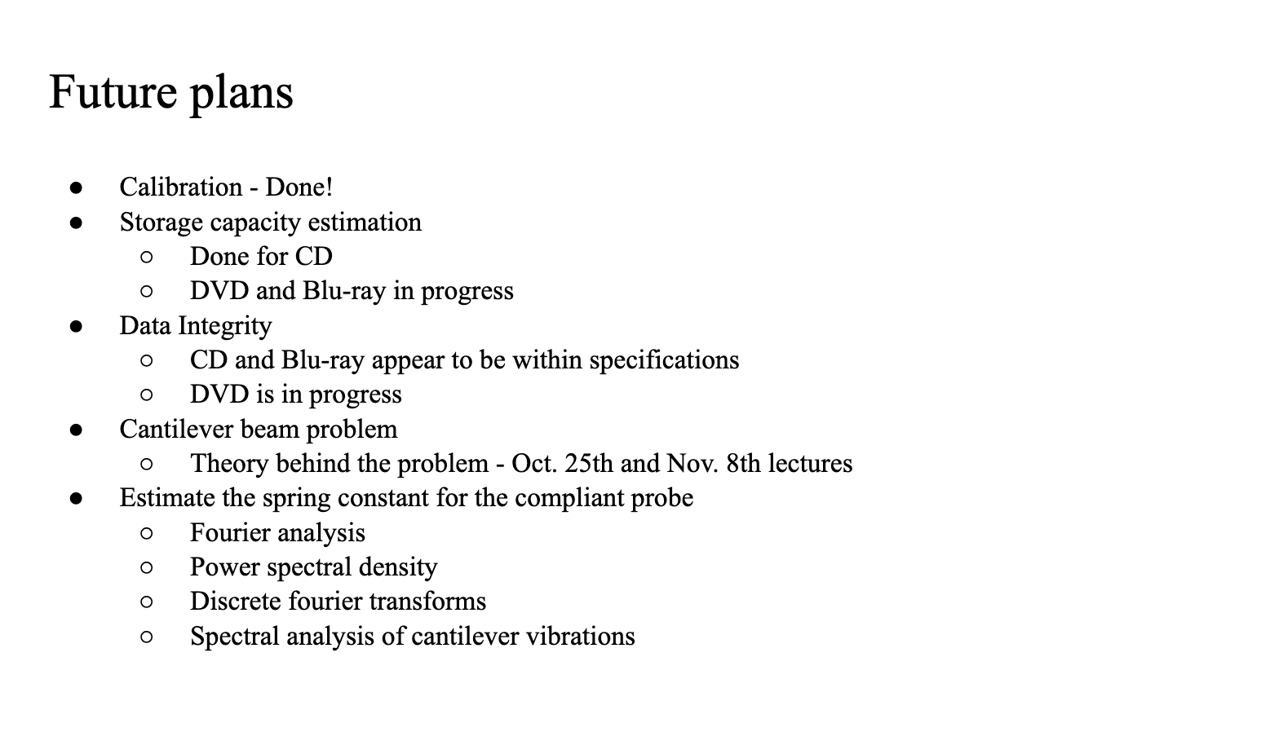
Notes:
The next part of your slide deck will be “work to be completed”
Make work to be completed into tasks that can be clearly articulated quickly–this slide does not do that!
This slide is obviously text heavy and includes bullet points, which don’t indicate level of importance or capture the process very well

Slide 52
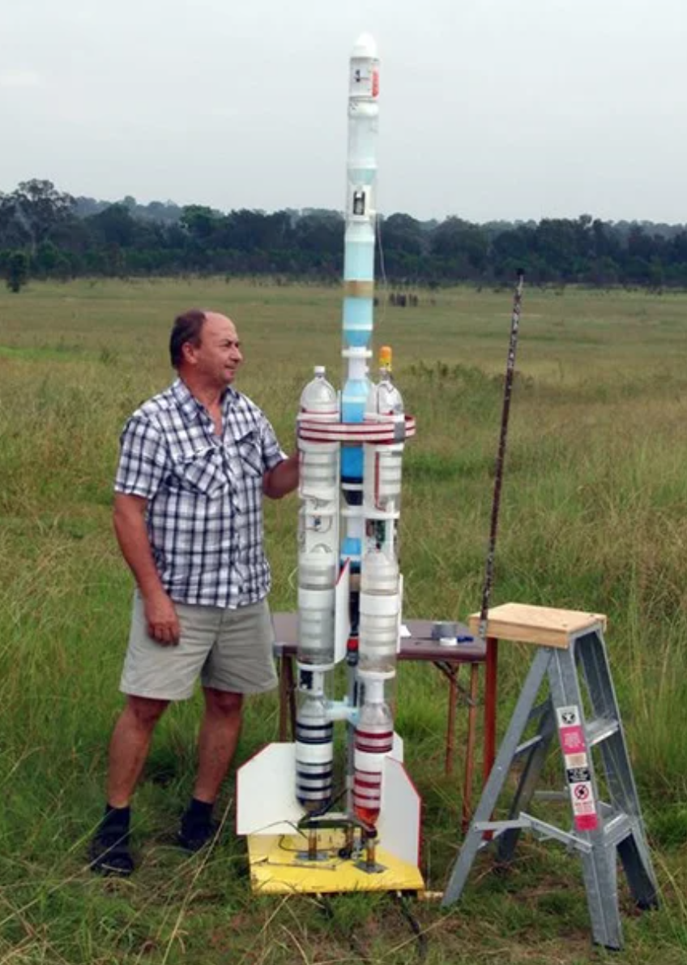
Make Your Last Slide Useful
Consider summarizing a couple of main points here
Say something impactful since this slide is projected during Q&A
Notes:
Be persuasive
Check out that bottle rocket!

Slide 53
Questions?
Notes:
Do NOT include a “questions” slide
It’s a waste of space
It doesn’t allow you to end strong

Slide 54
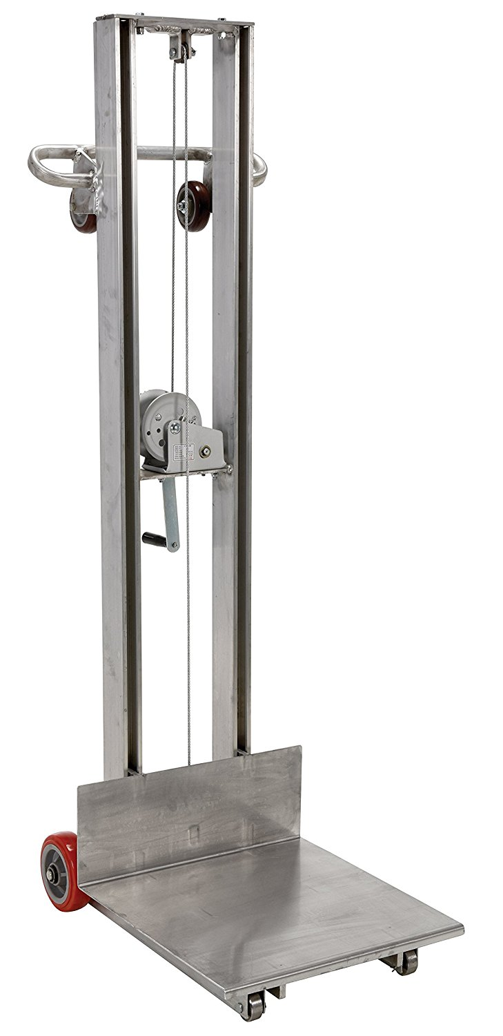
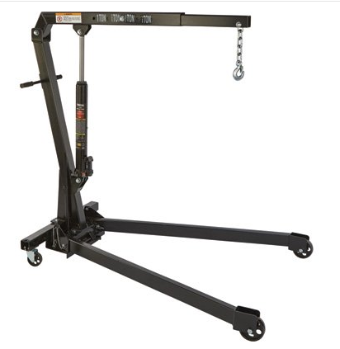
Lifting Alternatives
Manual Winch Lift
Small Engine Hoist
Notes:
a personal plea…
Please make your images transparent

Slide 55
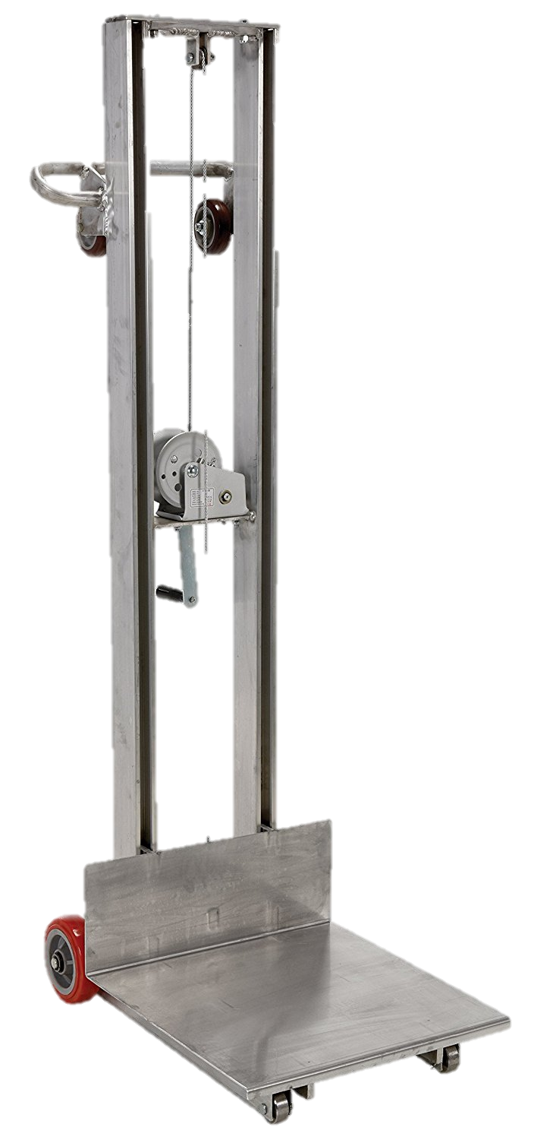

Lifting Alternatives
Manual Winch Lift
Small Engine Hoist
Notes:
Transparency applied
Now, let’s discuss delivery a bit

Slide 56
Good delivery…conveys the speaker’s ideas clearly, interestingly, and without distracting the audience.
Most audiences prefer delivery that combines a
certain degree of formality with the best attributes of
good conversation—directness, spontaneity, animation, vocal and facial expressiveness, and a lively sense of communication (Lucas, 2009).
Do NOT read from a script!
Notes:
Speak SLOWER than what you think you need to
Avoid filler words: the only way to cut this is to practice and to speak slowly and intentionally
Body position: refer to the visual aids on your slides
Look into the camera
Use hand gestures to mark order, signify important content, etc.

Slide 57
Plan Your Introduction Carefully
Practice your opening line WORD-FOR-WORD
Introduce yourself
Tell us why we are here

Slide 58
Practice your Technology Ahead of Time
If possible, practice in the actual room you will present
What does your background look like?
Are you in the frame of the camera?
Are you presenting without distractions?
Do colors appear as you intend?
Does sound work?
Is your audio crisp and clear?

Slide 59
Be Aware of Your Presentation Voice
Speak slowly and intentionally
You speak faster when nervous
You know the material–we do not
Pause
Give us time to process your material
Break at intentional moments
Use emphasis for main points: sound excited!
Speak louder or pause
Use gestures

Slide 60
Gestures and Eye Contact Matter
Make eye contact with the camera
Engage with your visual aid
Use the cursor to explain a process

Slide 61
End on a High Note
Practice your concluding line WORD-FOR-WORD
Do not end with, “and that’s my presentation”
Remind us of your bottom line
NO “thank you” or “questions” slide
Consider NOT displaying the works cited (but have it available)

Slide 62
Questions?
Just kidding…don’t do this

